Slide 1

JOURNEY PPT
Harshitha K U

Slide 2
SOFT SKILLS
Professional Behaviour.
Business Etiquette for chat, video and call.
Team work.
Having Trust in others.
Body Language.
Email formatting.
Fixed mindset v/s Growth mindset.
Leadership Quality.
Focus.

Slide 3
BUSINESS ANALYSIS AND AGILE
Learnt about business analysis and advantages of using Agile Methodology
Differences between Functional and Non Functional Requirements
Functional requirements is all about what can be done which is visible
Non Functional requirements is about security,performance,scalability and others
Scrum method and Kanaban method
Product Backlog and sprint backlog

Slide 4
Sprint Review
Three main pillars in sprint meetings are Scrum Master, Product Owner and Team member
Learnt about the role of Business analyst, Data Architect, Test Architect, Dev team, Product owner and scrum master
Exposed to the practical use of the tool Microsoft Azure which is used for the storage, Networking, pull the code, push the code, epic, user story, tasks and sub tasks.
We can collaborate with our team using Microsoft Azure.

Slide 5
DATABASE MANAGEMENT SYSTEM
Database Management System is a software used to create and maintain the database.
SQL – Structured Query language.
Oracle db,Microsoft azure,Jenkins and many more
Different commands related to DDL,DML,TCL,DCL,DQL.
Data definition language includes Create, Alter, Drop and Truncate.
Data manipulation language includes Insert, Delete, Update.
Data query language includes Select.
Transaction control language includes Grant and Revoke.
Data Control language includes commit, Rollback

Slide 6
SOFTWARE TESTING
Testing is all about finding defect.
There is no particular role for tester in scrum model.
Coding and testing happens in a simultaneous manner.
Unit testing, Integration testing ,System testing, Acceptance testing, UI testing, Component testing.
Fitnesse tool is used for testing.
Customer satisfaction and high level profit can be achieved through testing.
Test plan, Test strategy and many other factors are included.

Slide 7
DevOps
DevOps is a combination of Development and Operations
Development is all about coding. Operations is all about CICD i.e Continuous integration and continuous deployment.
The speed of delivering the applications and the services will be increased.
Continuous deployment and continuous feedback.
Work becomes faster and more flexible.
It has lot of advantage when compared with the old method.

Slide 8
CLOUD COMPUTING
Cloud computing is all about on demand self service.
Internet is must.
Security threats may happen. Since the data is stored at the server end. Cyber attacks possibility is there.
Infrastructure as a Service(IaaS)
Platform as a Service(PaaS)
Software as a Service(SaaS)
Low cost i.e. Cost Effective.
Pay as much as used and needed.

Slide 9
Case study
Github Actions
Git Fork and pull request
Docker, Maven installation
DevOps case work
Microsoft Azure

Slide 10
Data Fundamentals
Database, DBMS, Datalakes
Operation support system and Decision support system
Datawarehouse is a collection of database that is subject oriented and integrated.
Data Mining
Data Modelling and Dimension modelling
OLTP vs OLAP

Slide 11
Azure SQL
Creation of Tables
Insertion
Working on queries related to Fetching, updation.
Structured, Unstructured and SemiStructured data
Join, Insert, Delete, Update.
Creation of SQL database in Azure portal.

Slide 12
Key value database
Document oriented database
Wide columnar database
Graph based database
DataWarehouse
ETL Tool
Analysis Tool
Azure SQL Database

Slide 13
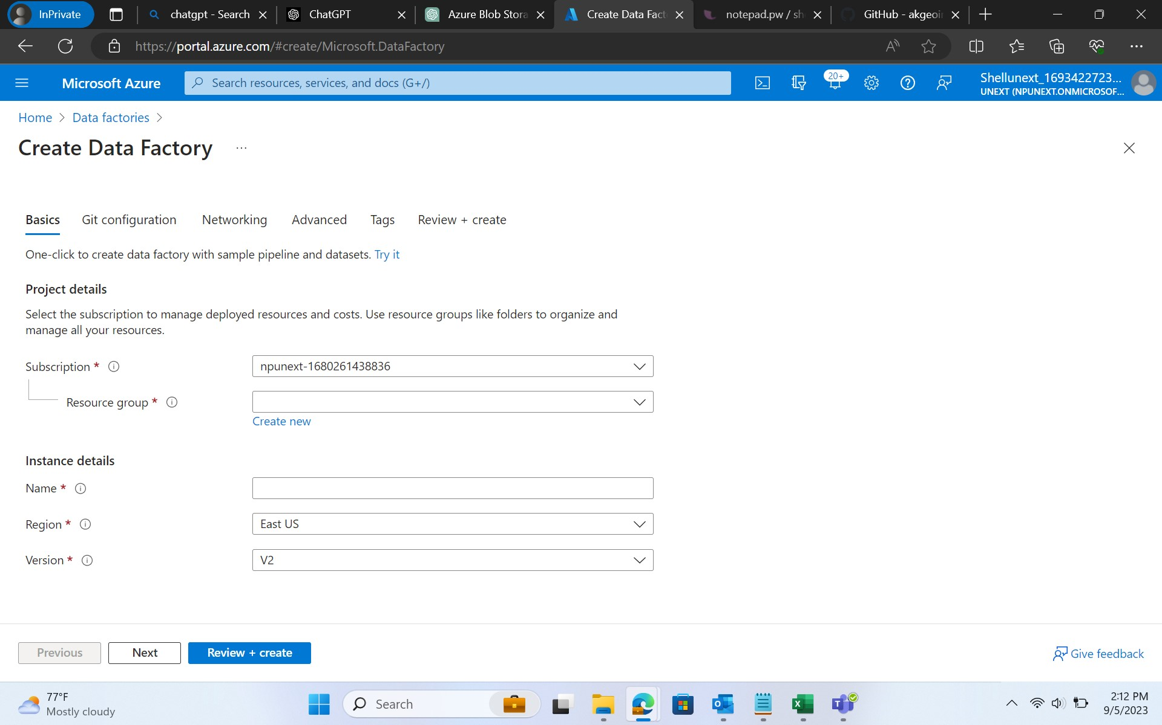
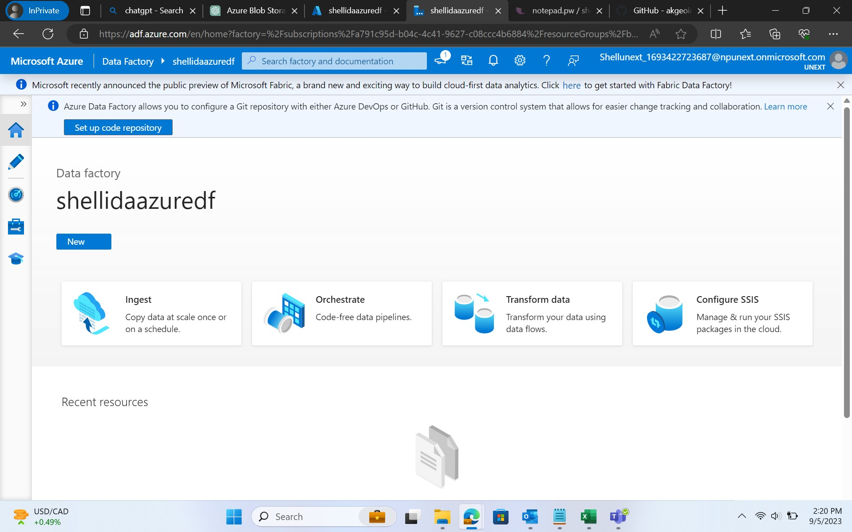
Creation of a Data Factory

Slide 14
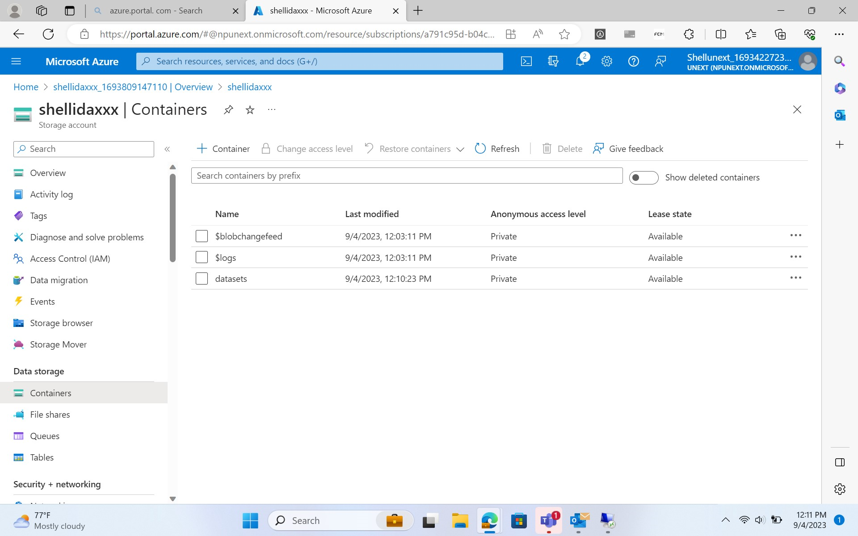
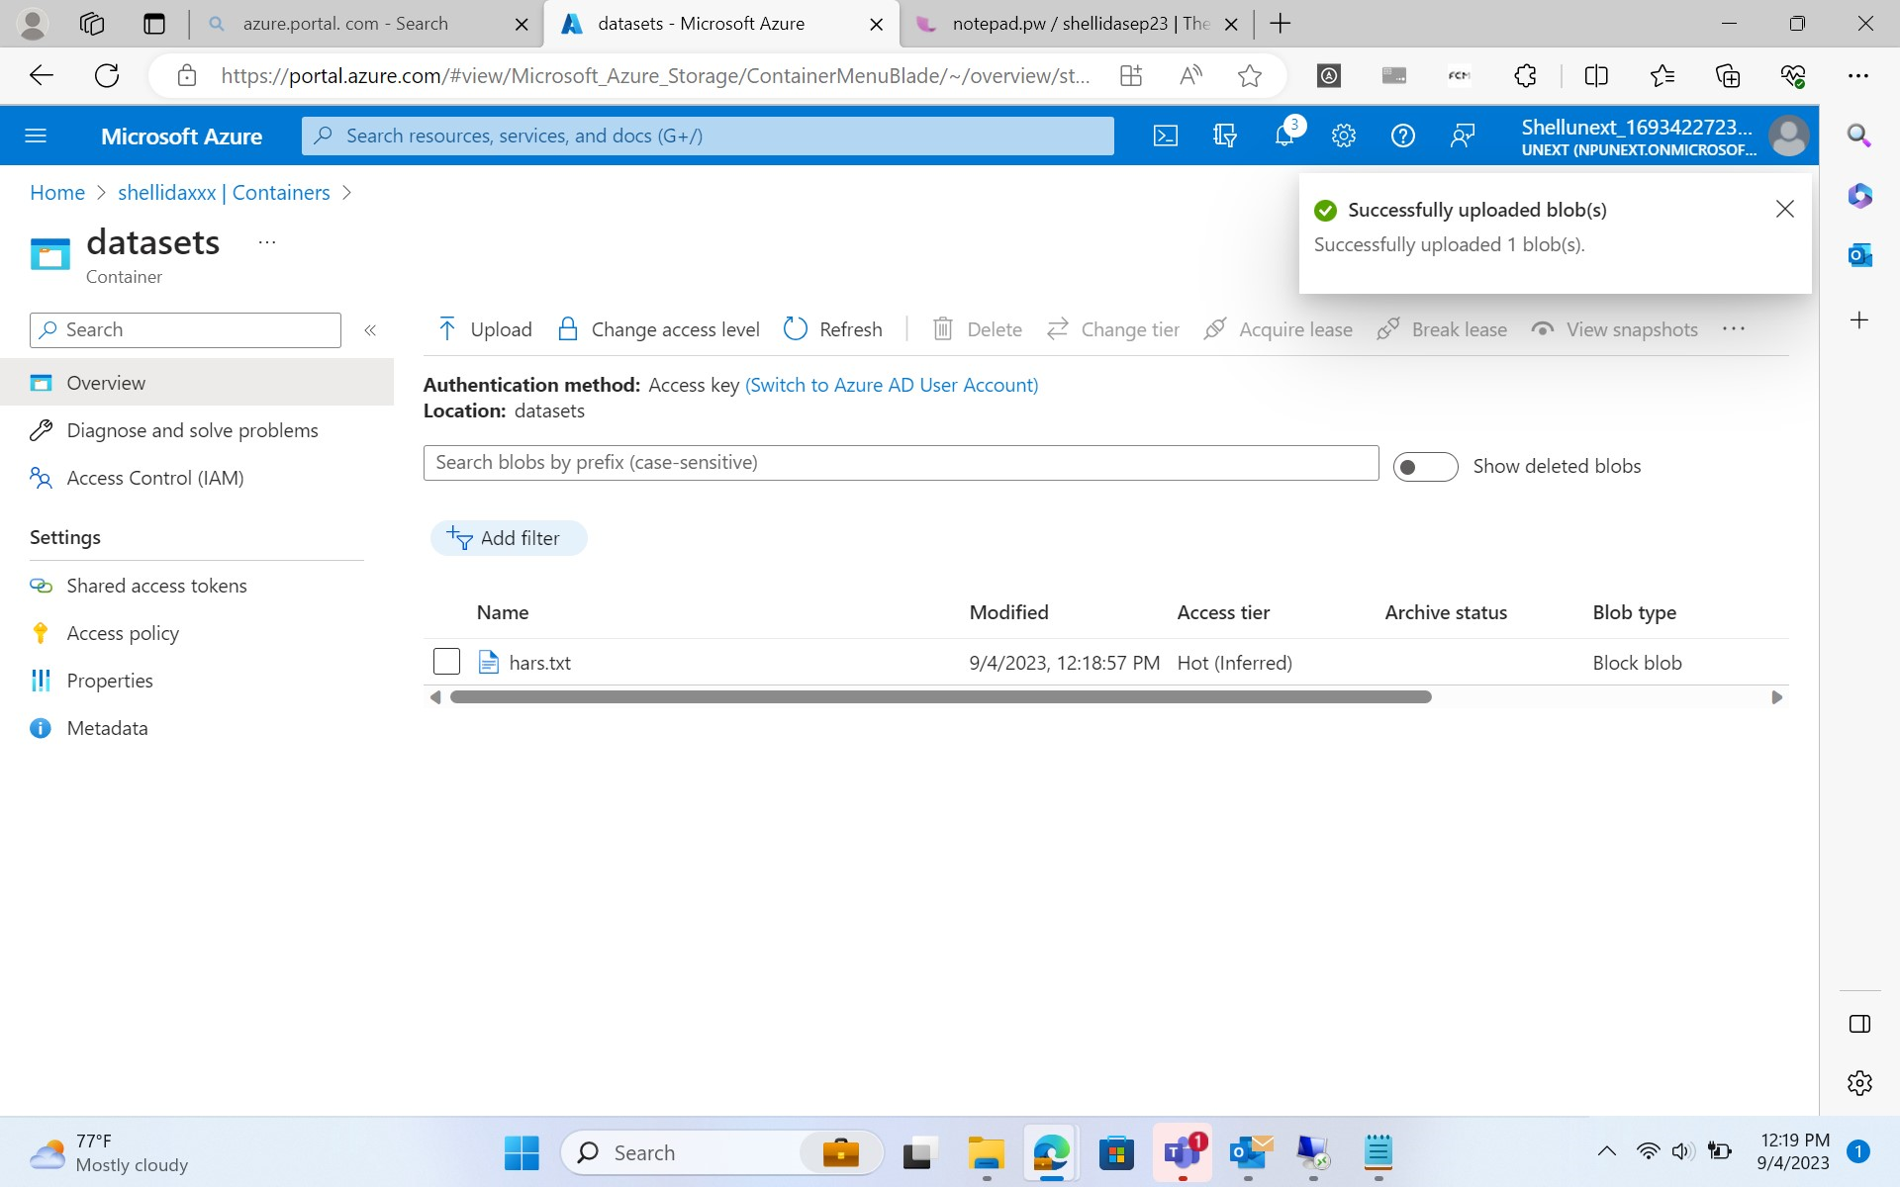
Azure Storage Account creation and creation of a container

Slide 15
Azure storage type day-1
*Introduction to Azure storage in Microsoft Azure portal
*Azure storage redundancy option
*Azure blob storage
*Data Lake Gen2 Storage
*Container concept, File share, Queue and tables
*Create data lake gen2 and manage it
*Compare Data Lake Storage Gen2 and Azure Blob Storage

Slide 16
Azure storage type day-2
*Access and authentication
*Secure Access to Azure Storage
* upload data into data lake gen2
*Azure Data Factory introduction
*ELT vs ETL
*Dataset , Integration run time
*parameters, system variables
*Pipeline, pipeline chaining

Slide 17
Azure Data Factory Day-1
*ADF components
*Copy Data Flow activity in ADF
*Linked services, Input & Output Data Set in ADF
*Control Flow Activity
*Get Metadata Activity
*Filter and If Activity
*Wait and foreach loop activity

Slide 18
Azure Data Factory Day-2
*Mapping Dataflow Transformation ,source transformation, sink transformation, surrogate key transformation
*Conditional split transformation, Derived column transformation
*API- based Integration : Understanding
*Exploring the API – based Integration
*Introduction to CDC
*Understanding CDC in context of database and system
*Use cases for CDC and its benefits in integration scenarios.

Slide 19
Azure Data Factory Day-3
*Hands-on on sql database creation
*loading the tables into the storage account
*Creation of pipeline for sql database
*Fetching, updating rows of a table and getting affected in adf and datastorage
*Creating the dataflow and cdc for the instances
*Debugging and triggering the dataflow and cdc
*Repitation of whole one week concepts
*Creating the automation account

Slide 20
Azure Synapse Analytics
*Creation of azure synapse analytics account
*It uses ADLS for the storage of the data
*Linkage to the Azure SQL and ADLS for storage of the data
*Data Ingestion and Preparation.
*Perform data preparation tasks.
*Creating the automation account

Slide 21
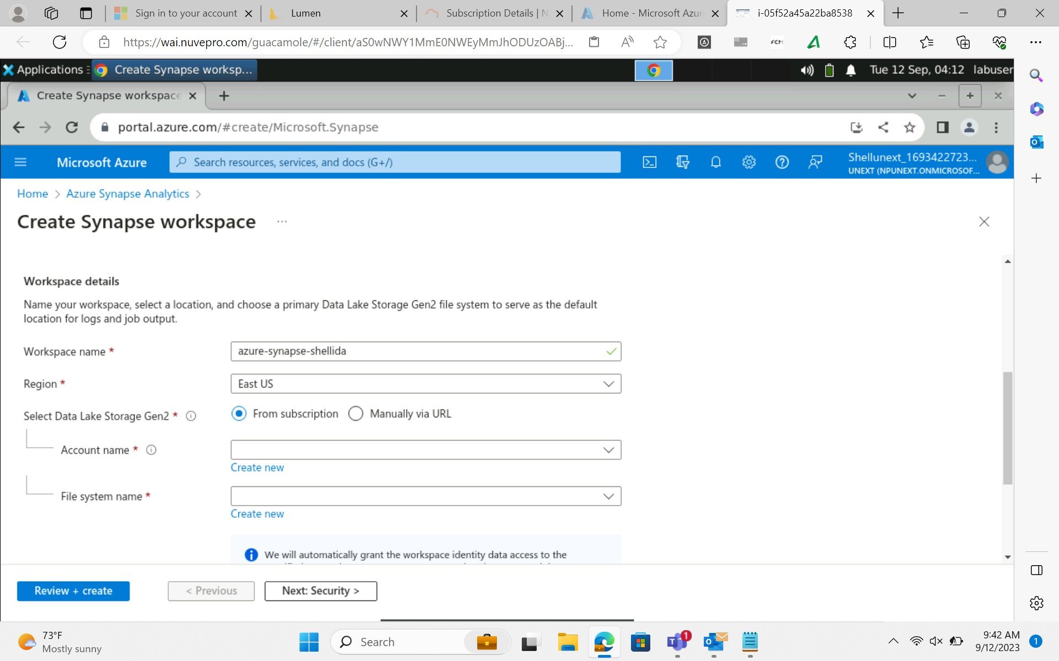
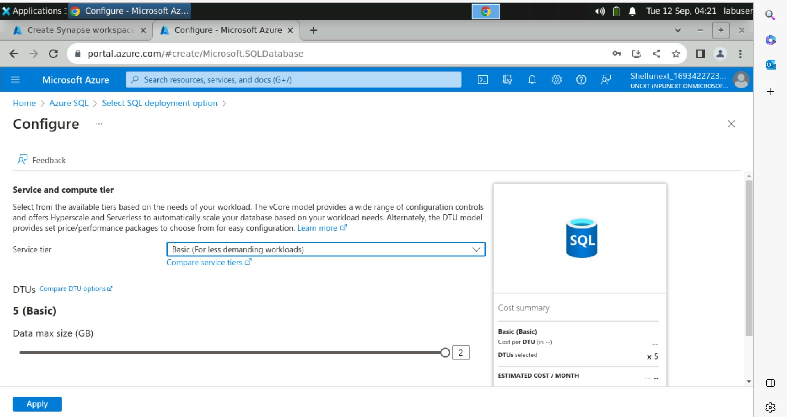
Azure Synapse Analytics

Slide 22
*Data visualization tool
*Used for making reports,dashboards
*Gives many meaningful insights about the data.
*Most powerful tool for gaining knowledge about the data
*BI stands for business intelligence
*worked on sql server management studio for connecting the data from the server end
*creating relationships between tables and hierarchies inside the table
*Load the data,Transform the data like cleaning,removing the duplicate rows,filtering and removal of null values.
Power BI

Slide 23
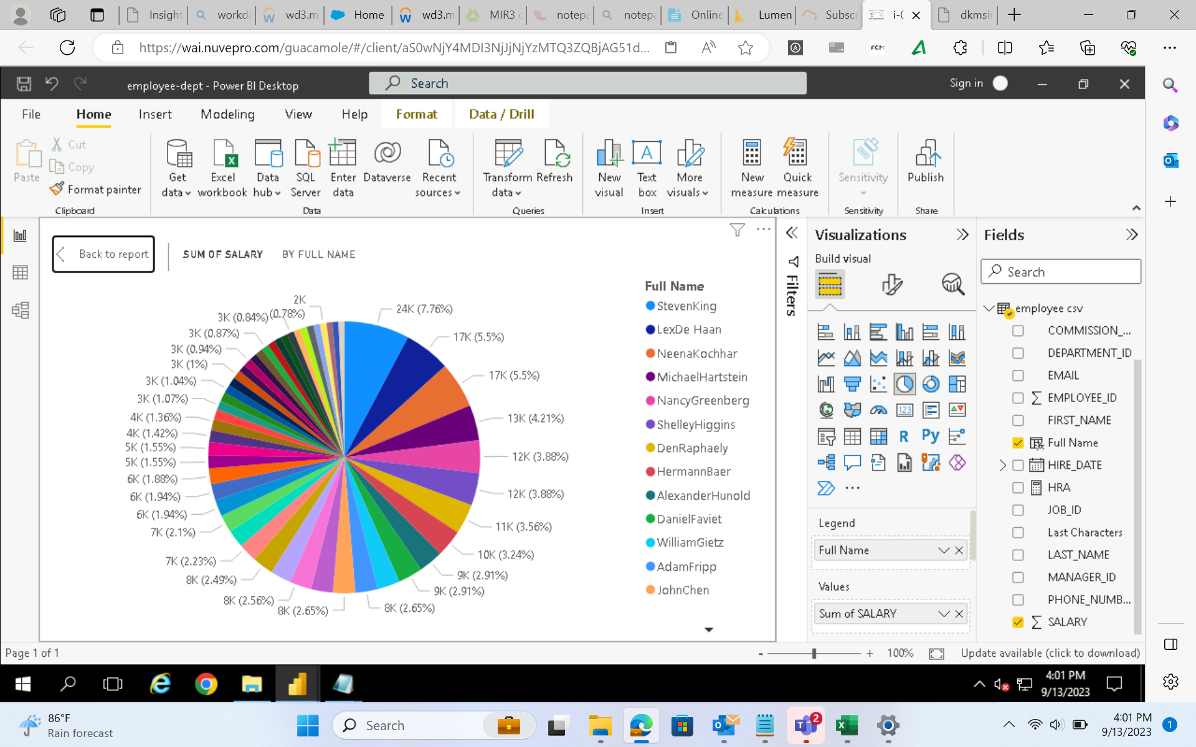
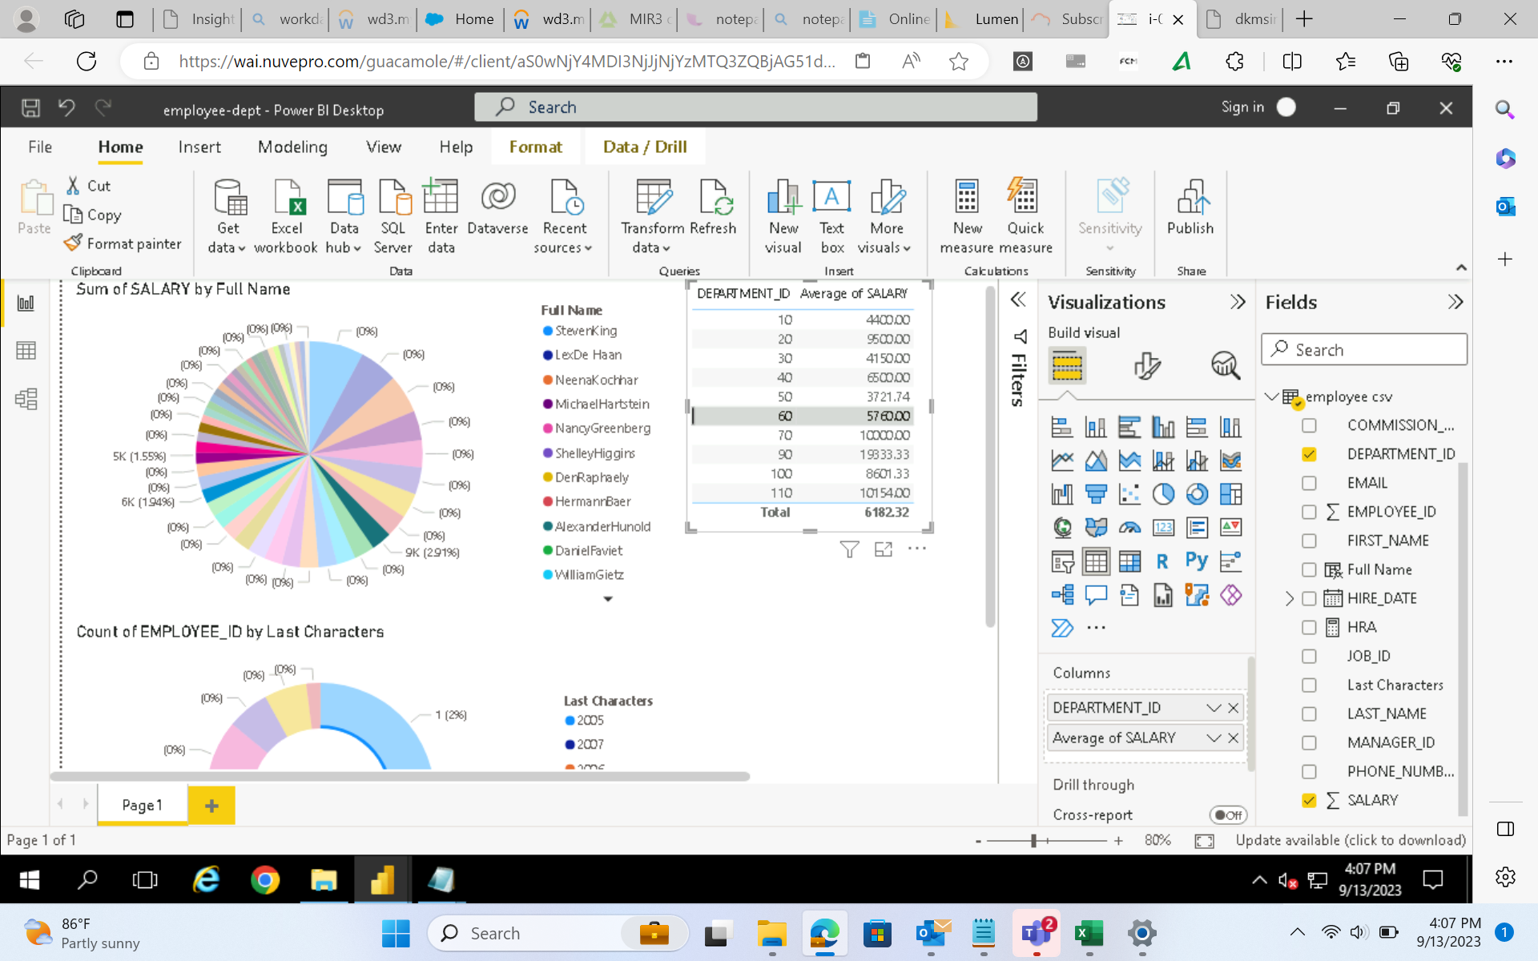

Slide 24
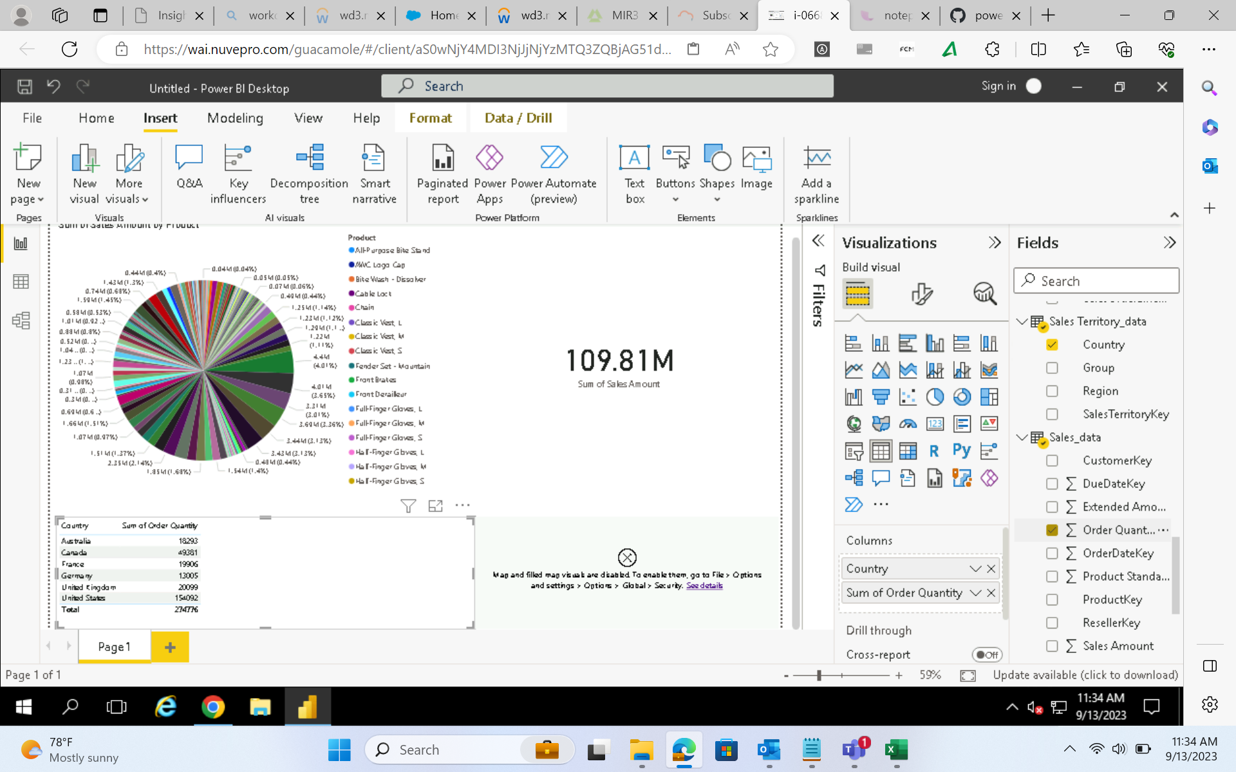
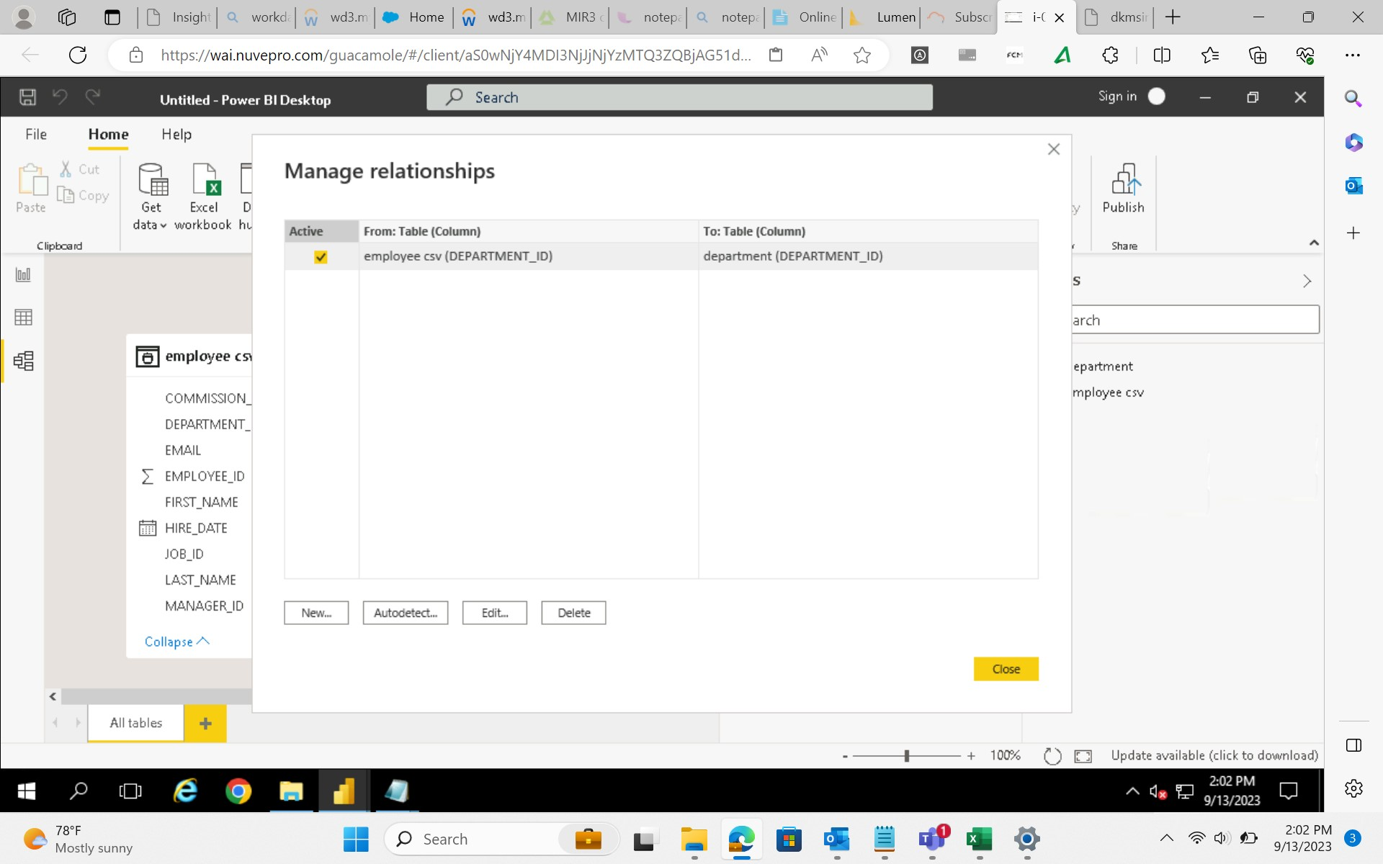

Slide 25
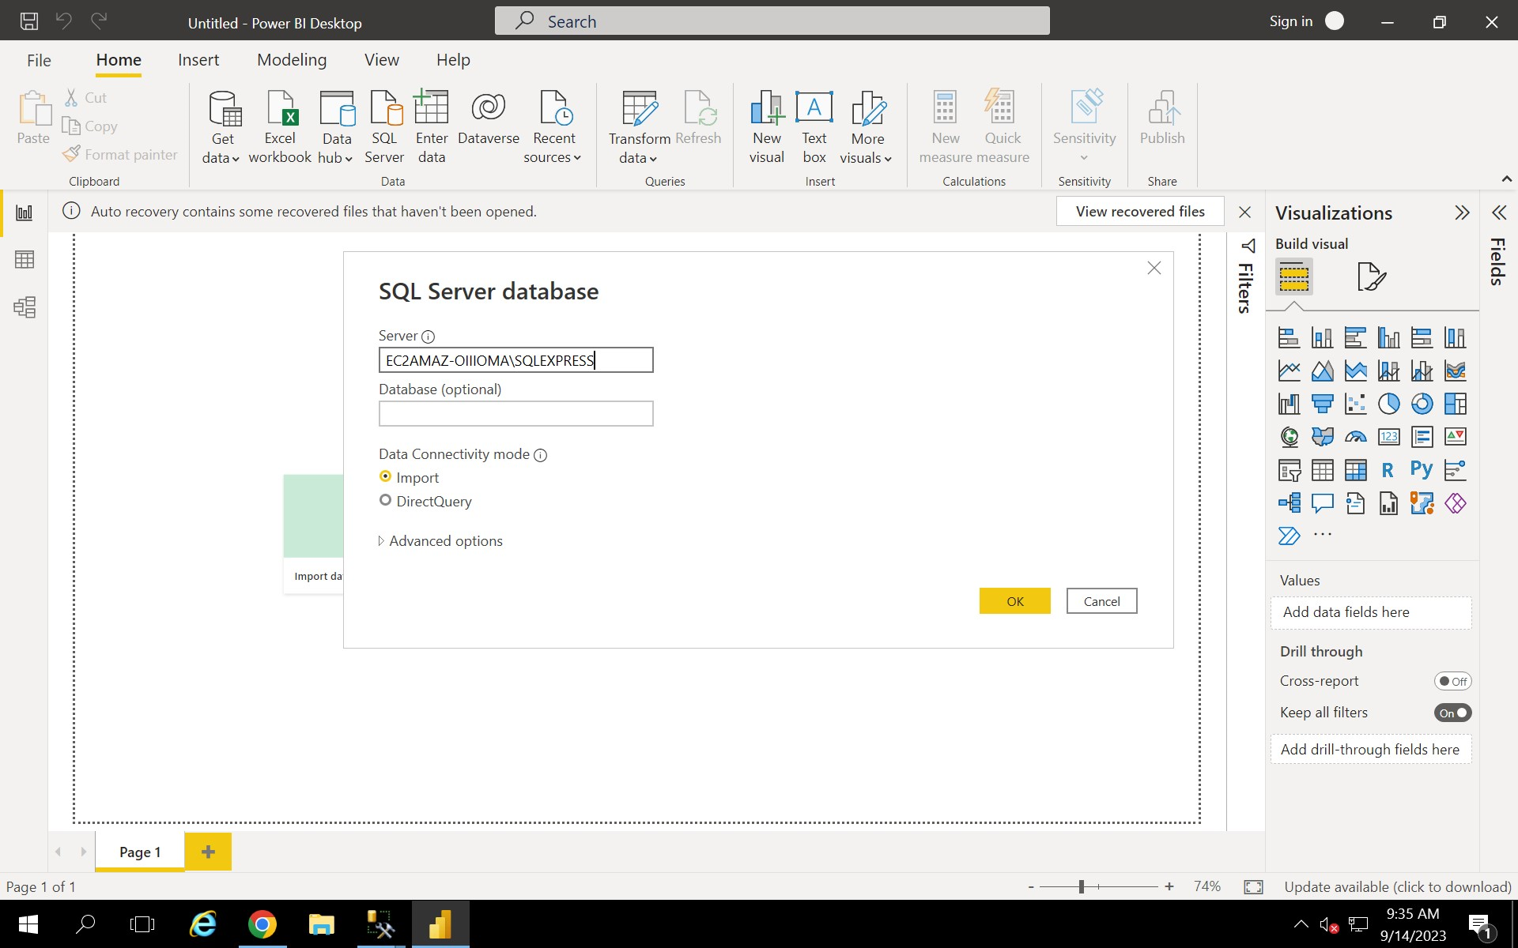
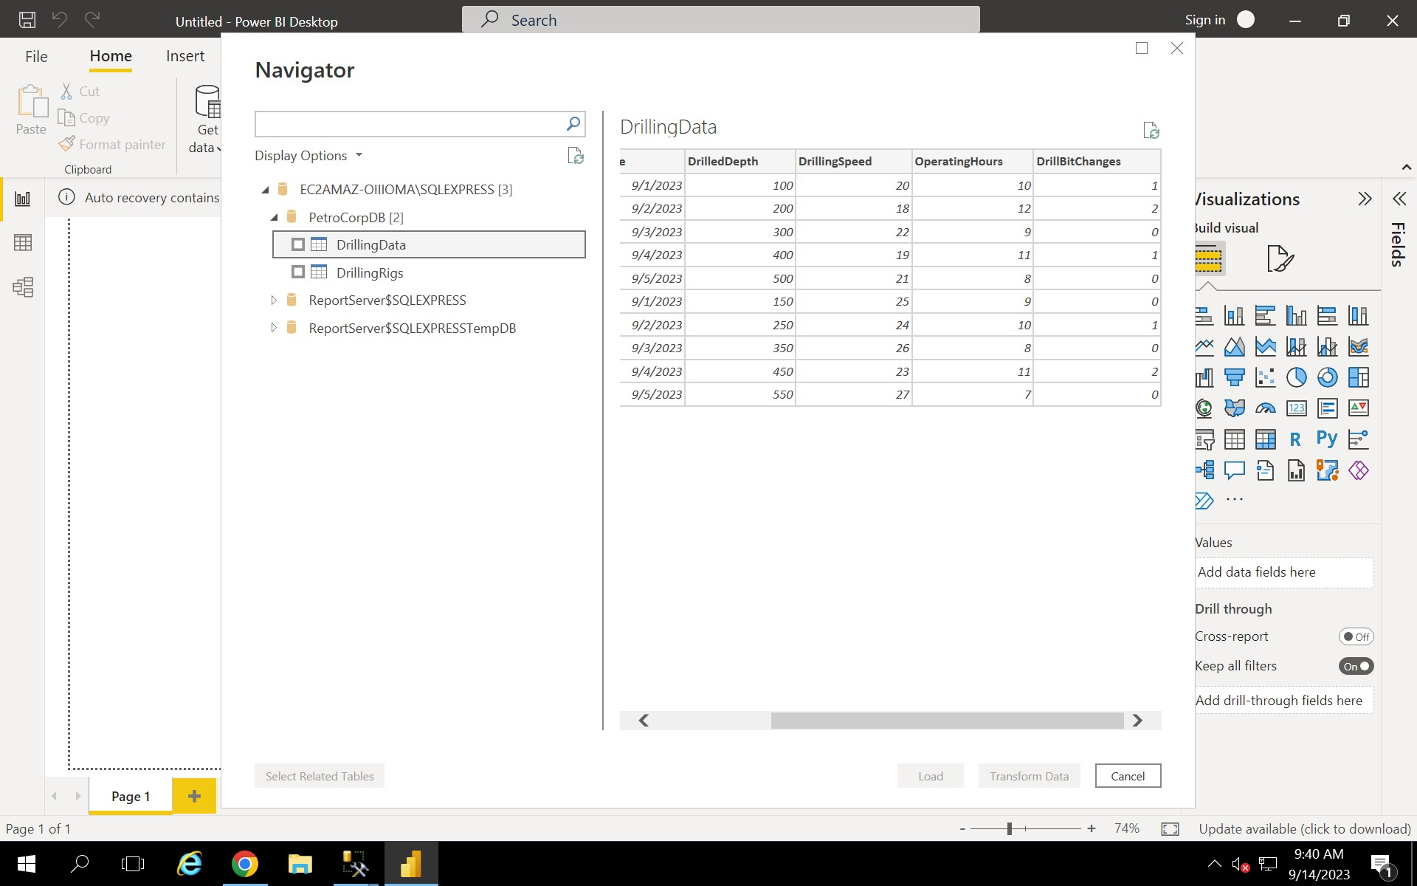

Slide 26
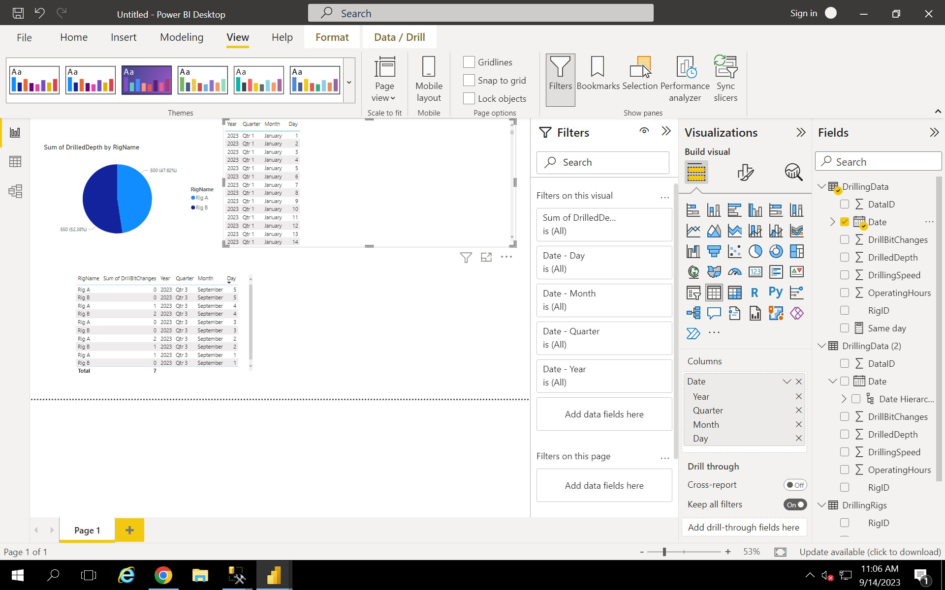
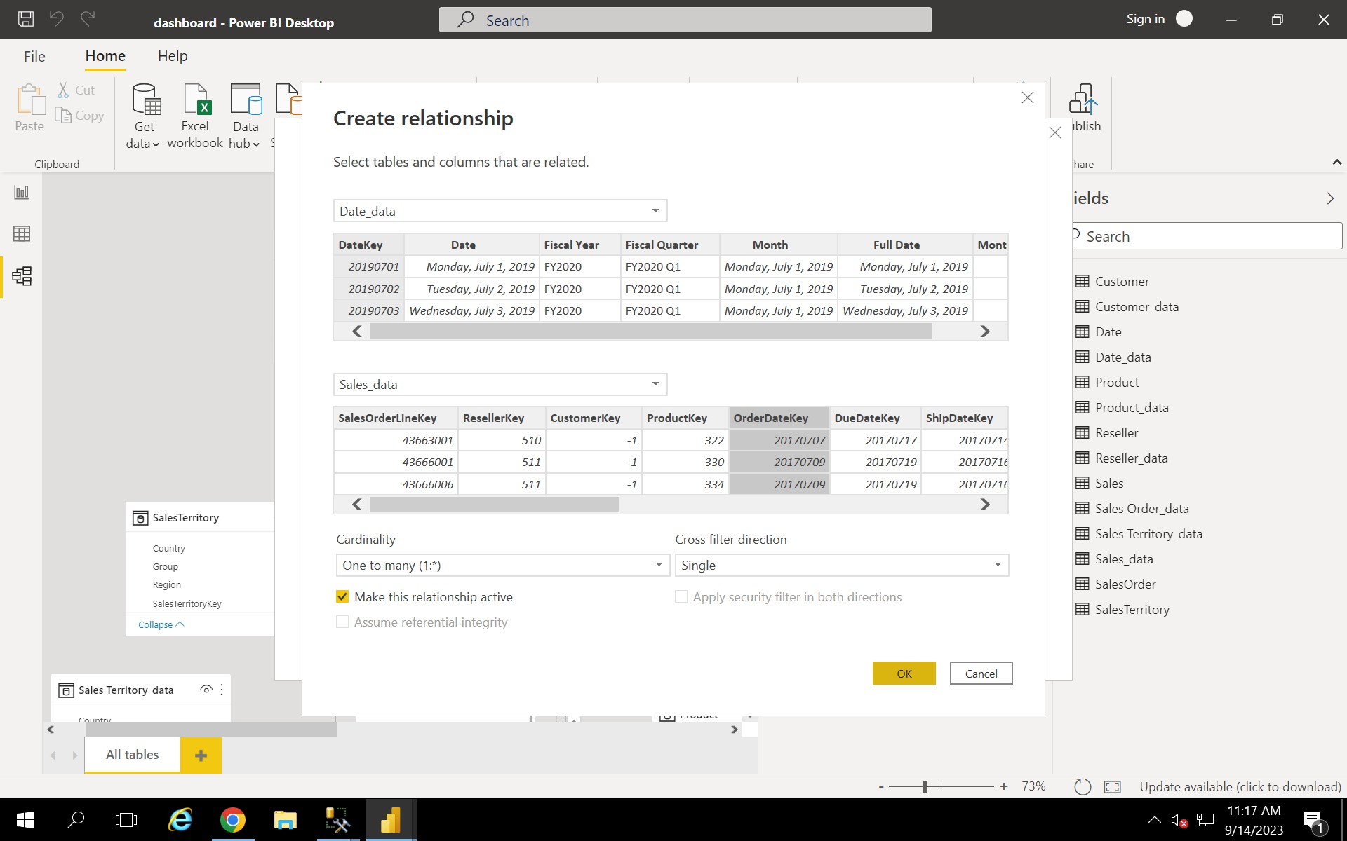

Slide 27
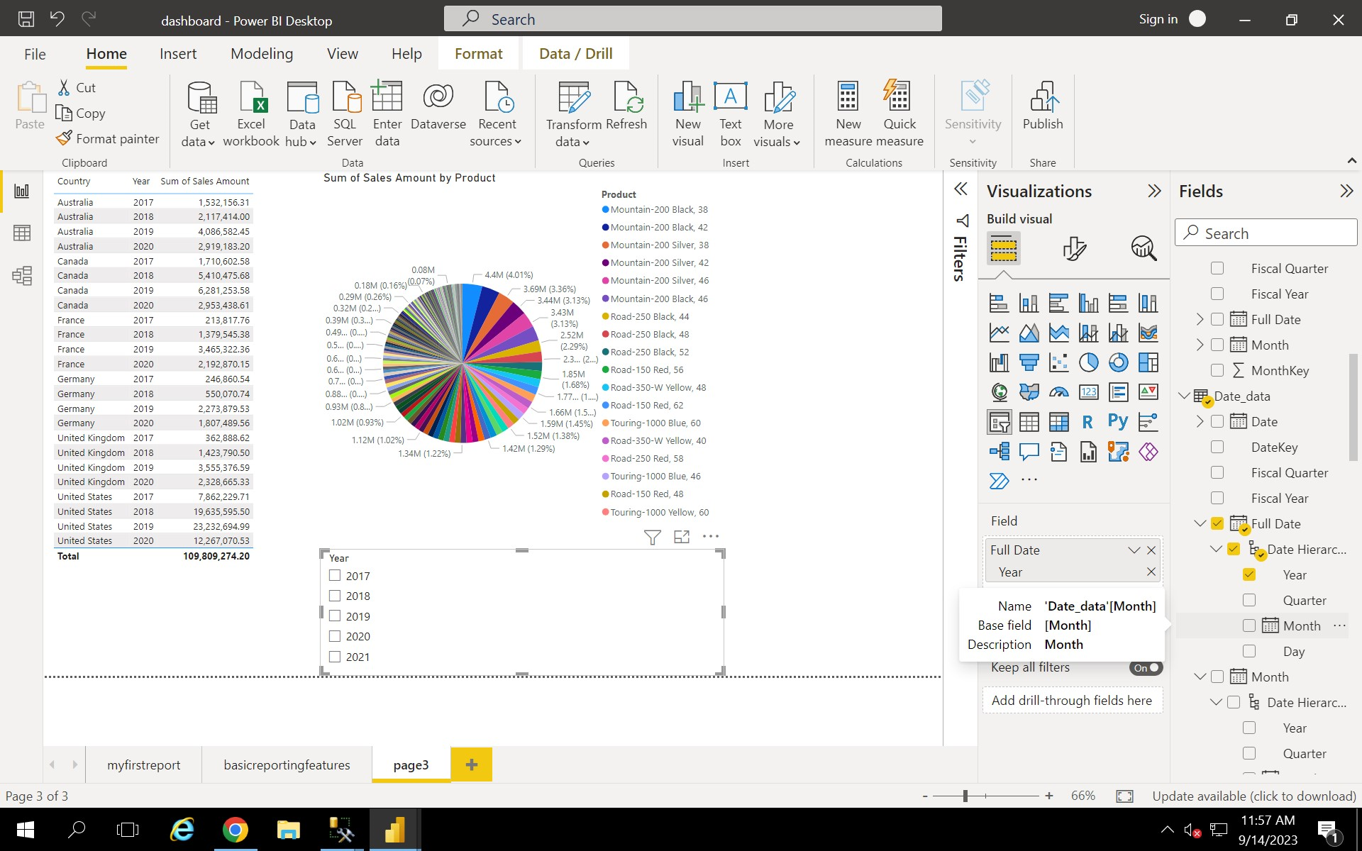

Slide 28
Python
*pandas library
*Numpy library
*Matplotlib library
*Different datatypes like integer,float,boolean
*Data structures like list,tuple,set,dictionary
*Features of python
*Positional and keyword arguments
*Sea born

Slide 29
*args and kwargs functions
*lambda function
*Different visualization charts like box chart, scatter chart.
*Scikit-learn, Scipy
*Nesting,iteration,range() function.
*User defined function.

Slide 30
Pyspark
*Unified data analytical tool for the large amount of data.
*Different clusters like Kubernetes,Mesos,standalone.
*Transformation and Action
*Different works like batch data processing,real time processing,machine learning and graph related processing named Graphix.
*Architecture,components of pyspark like jobs,stages,task and many other.
*collect() performed on resilient distribution dataset.
*show() performed on dataset

Slide 31
*count(),filter(),dropDuplicates,first(),head(),tail()
*Basic syntax is spark.read.csv(file path)
*In the above syntax other options like header true, inferSchema true,printSchema,spark session creation,stoping the spark session,creation of dataframe and displaying the content.
*spark-sql entry into terminal and executing basic sql queries.
*partition/piece of code.One partition → one task → one executor.
*stage divided into task.

Slide 32
*spark -> polyglot -> multiple languages -> C#,R,python,scala.
*saving the file or writing the file.
*CRUD operations – create,read,update and delete
*syntax for writing the file is write.format(“”).save(“file path”). In format we can specify json,parquet,orc → optimized row columner.
*spark session can be stopped using spark.stop()
*from pyspark.sql import SparkSession
*usage of pyspark terminal and spark-sql terminal.launch of local host to see the execution status of jobs and there task completed status,storage and many others.

Slide 33
Azure Data Bricks
*Creation of a azure data bricks account and launch the workspace.
*Azure data bricks is a commercial application where spark is a open source application.
*Azure data bricks is cloud related one whereas spark is a on-premises application.
*Batch processing and stream processing.
*Reading and writing of the streaming data using readStream and writeStream options.

Slide 34
Azure Data Bricks
*Azure data bricks using pyspark and spark sql.
*DataFrames and Data bricks file system in azure data bricks.
*Creation of the notebook and concept of unity catalog.
*Creation of the notebook and concept of unity catalog.

Slide 35
Azure Containers
*Docker Containers and Docker images.
*Build a containerized sample analytical web application.
*Container registry.
*Kubernetes deployment and its services.

Slide 36
Azure DevOps
*Development and operations performed continuously.
*plan,code,test,deploy,release.
*Three main phases – Development,Testing and production.
*Github.
*CI/CD practices with github applications.
*Automation
*Github branches and repositories.

Slide 37
Azure ML studio
* Azure ML services and features.
* Machine learning algorithms.
* Managing datasets in azure ML.
*Exploring and visualizing the dataset.

Slide 38
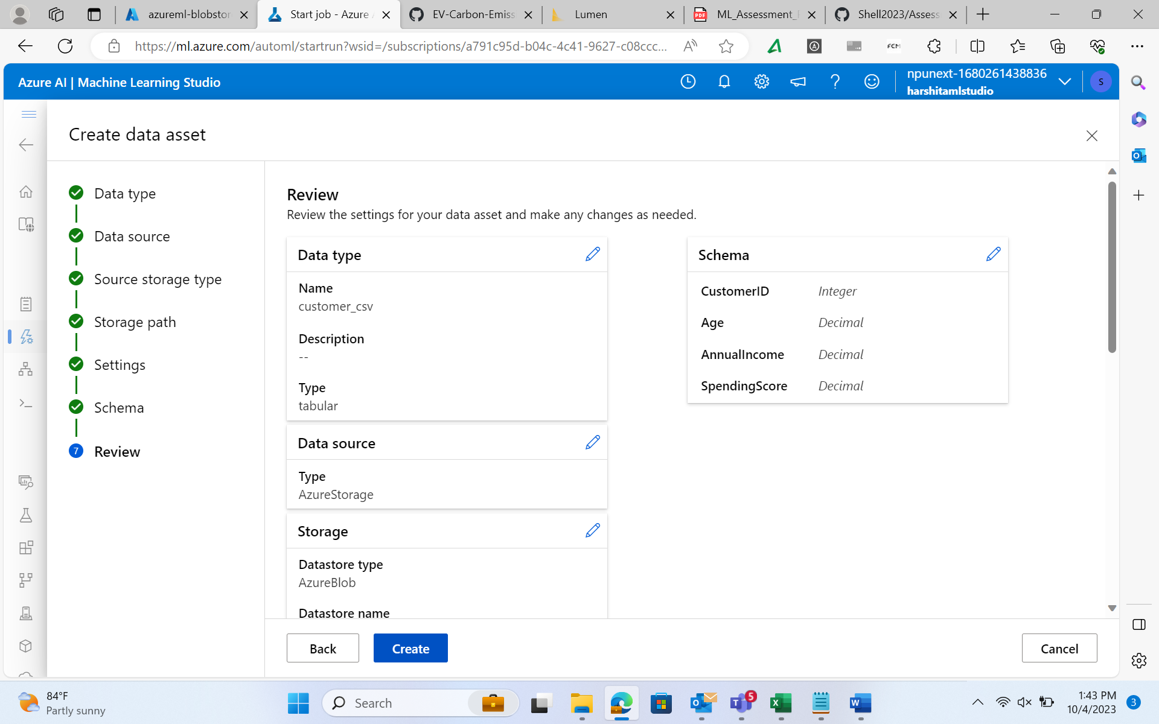
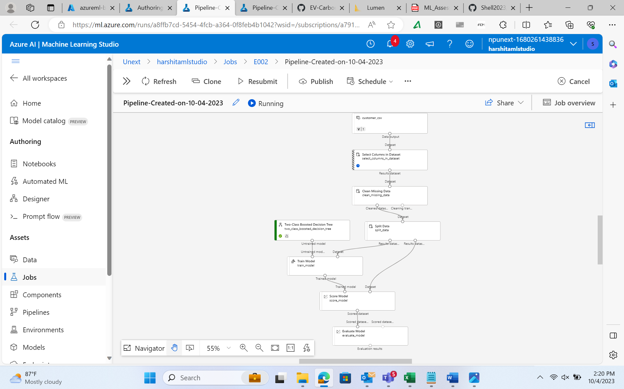

Slide 39
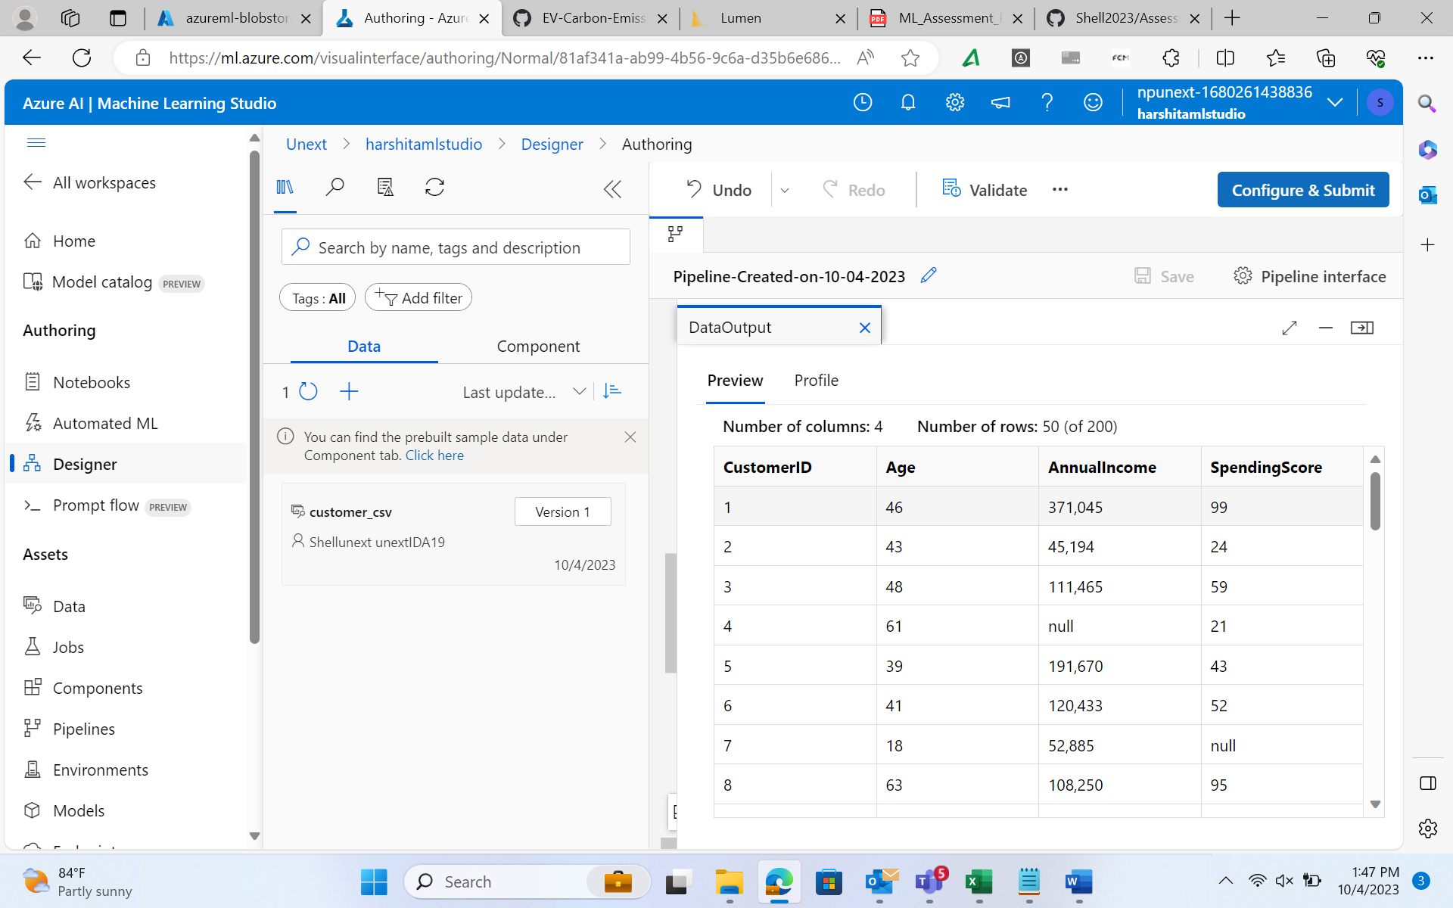
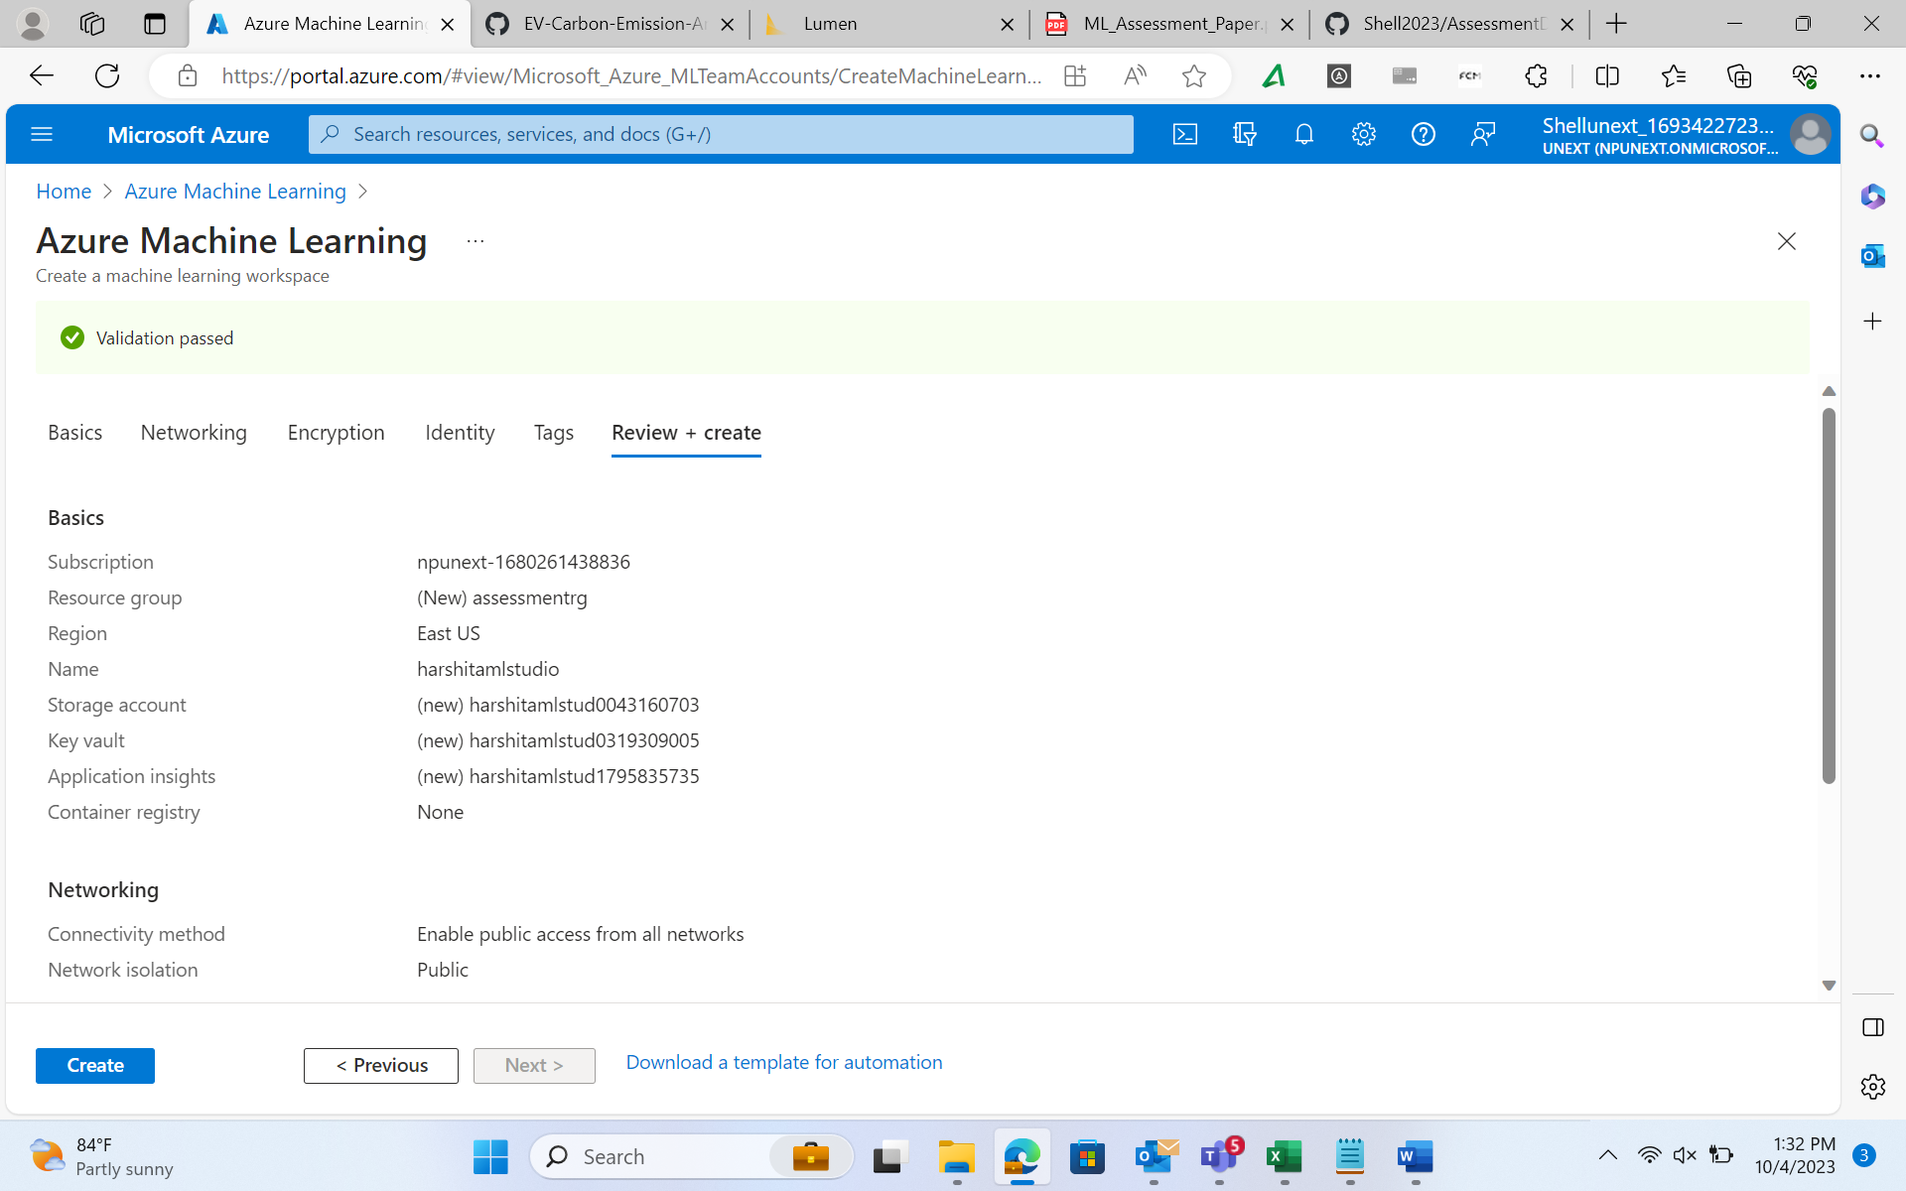

Slide 40
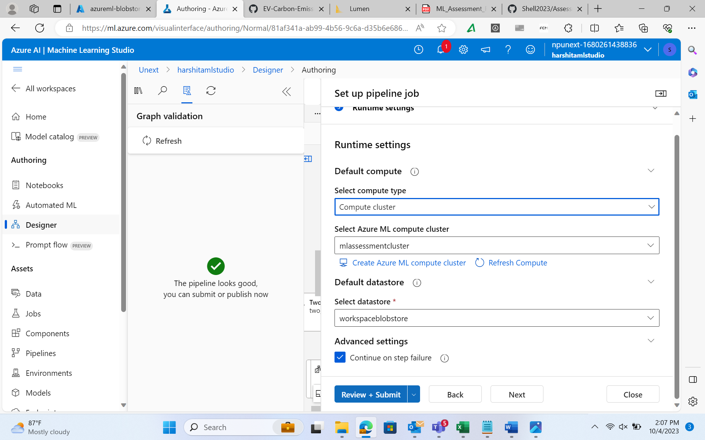
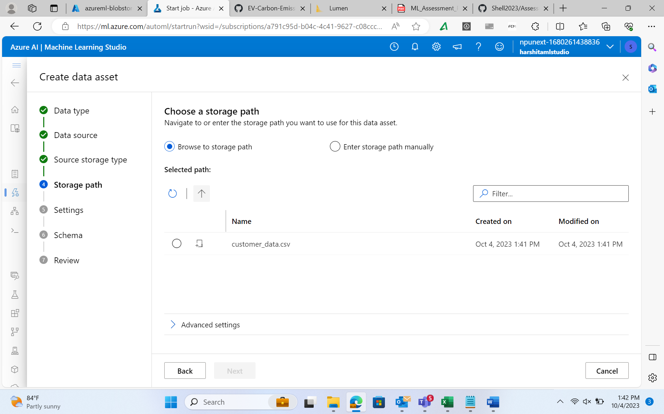

Slide 41
Github Link
harshithakumesh/Shellprojects (github.com)

Slide 42
Case Study
Electric Vehicle Carbon emission Analysis

Slide 43
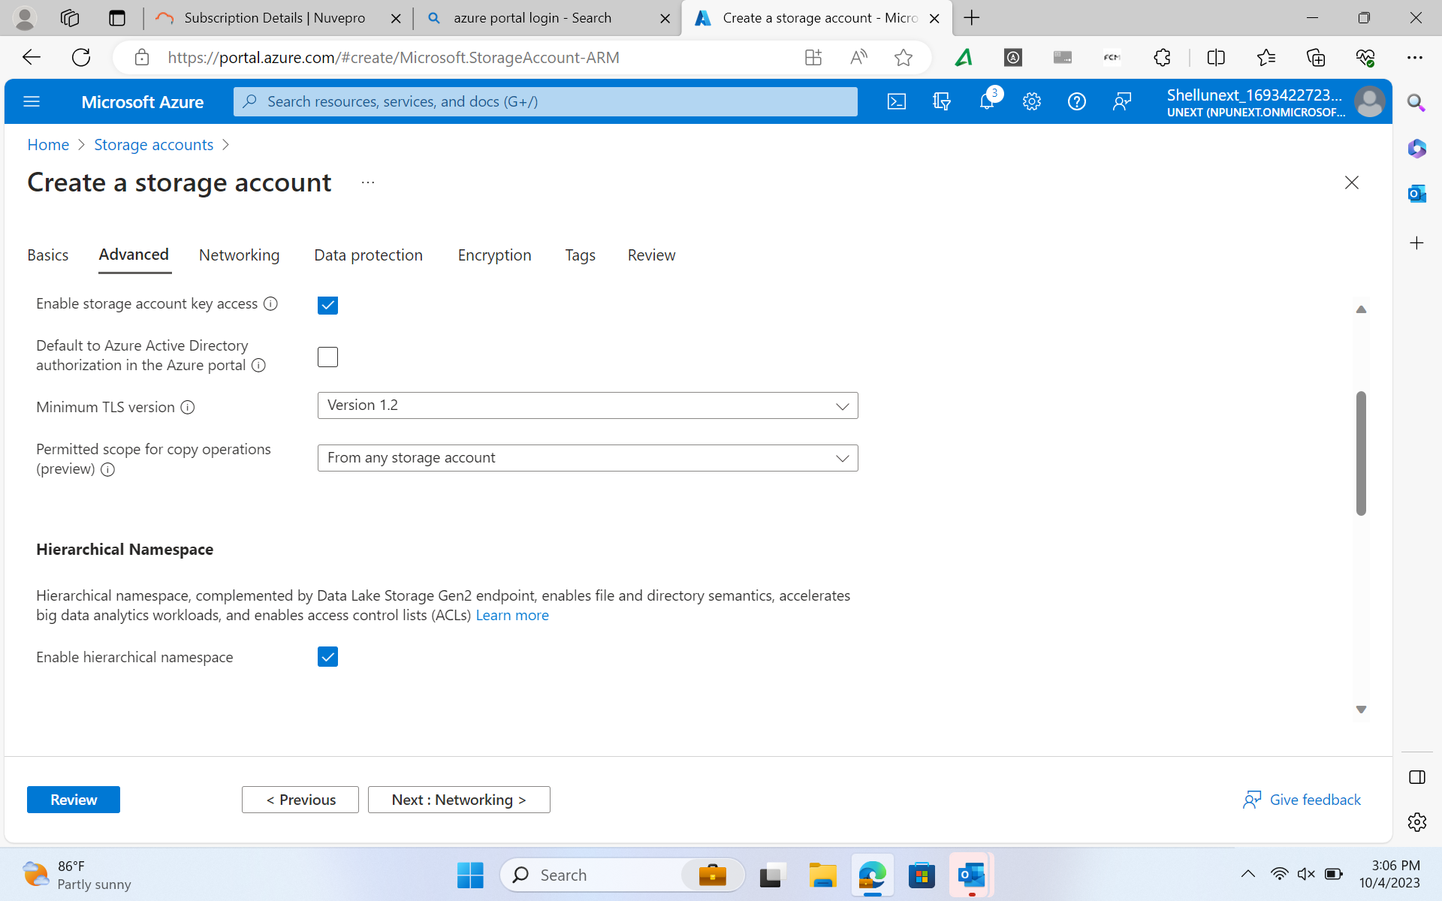
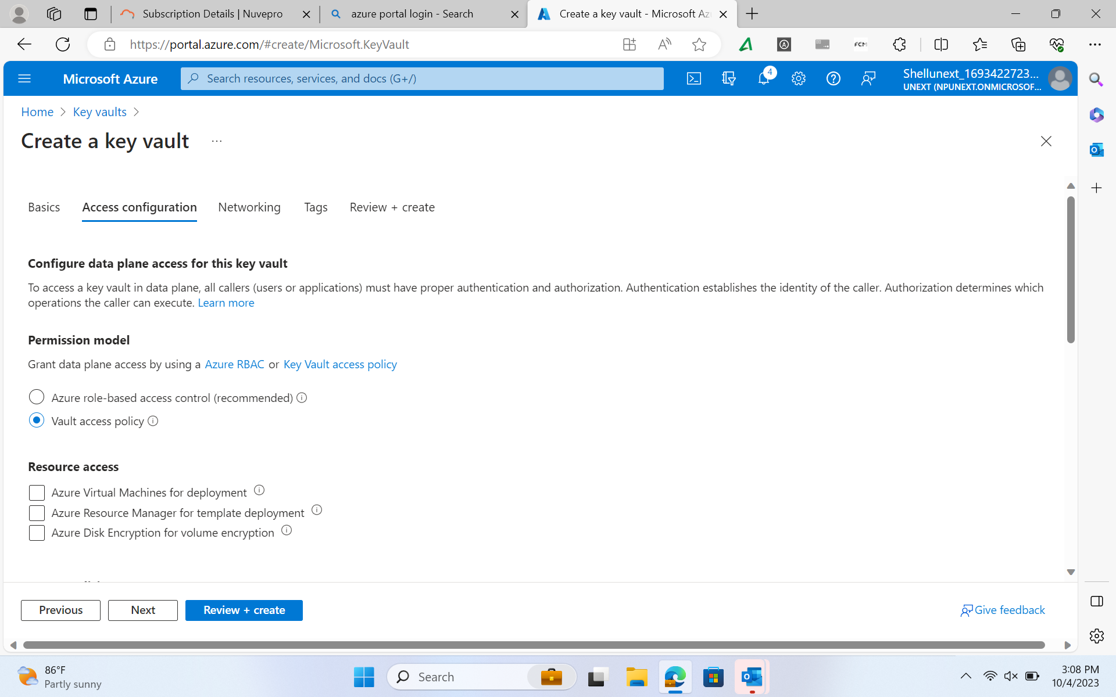

Slide 44
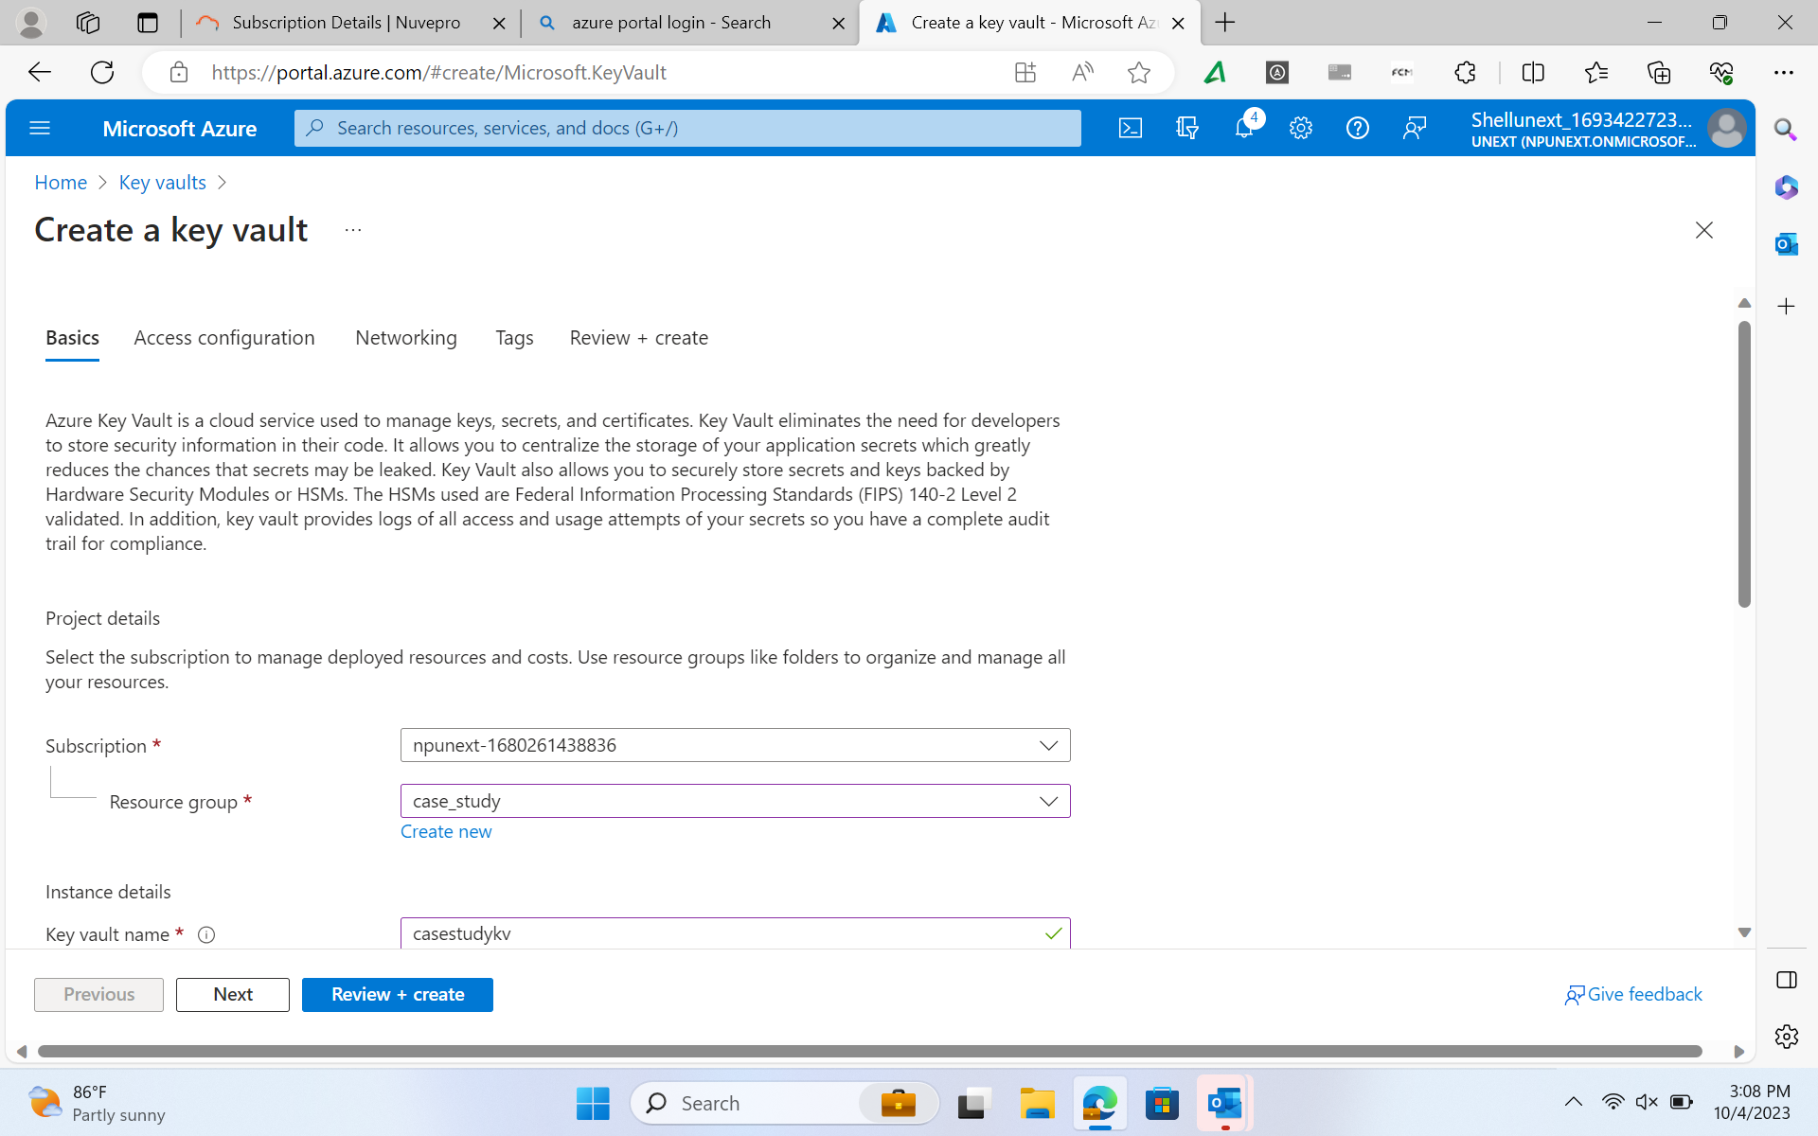
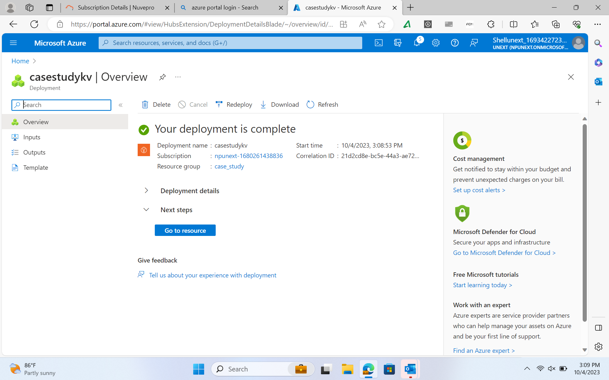

Slide 45
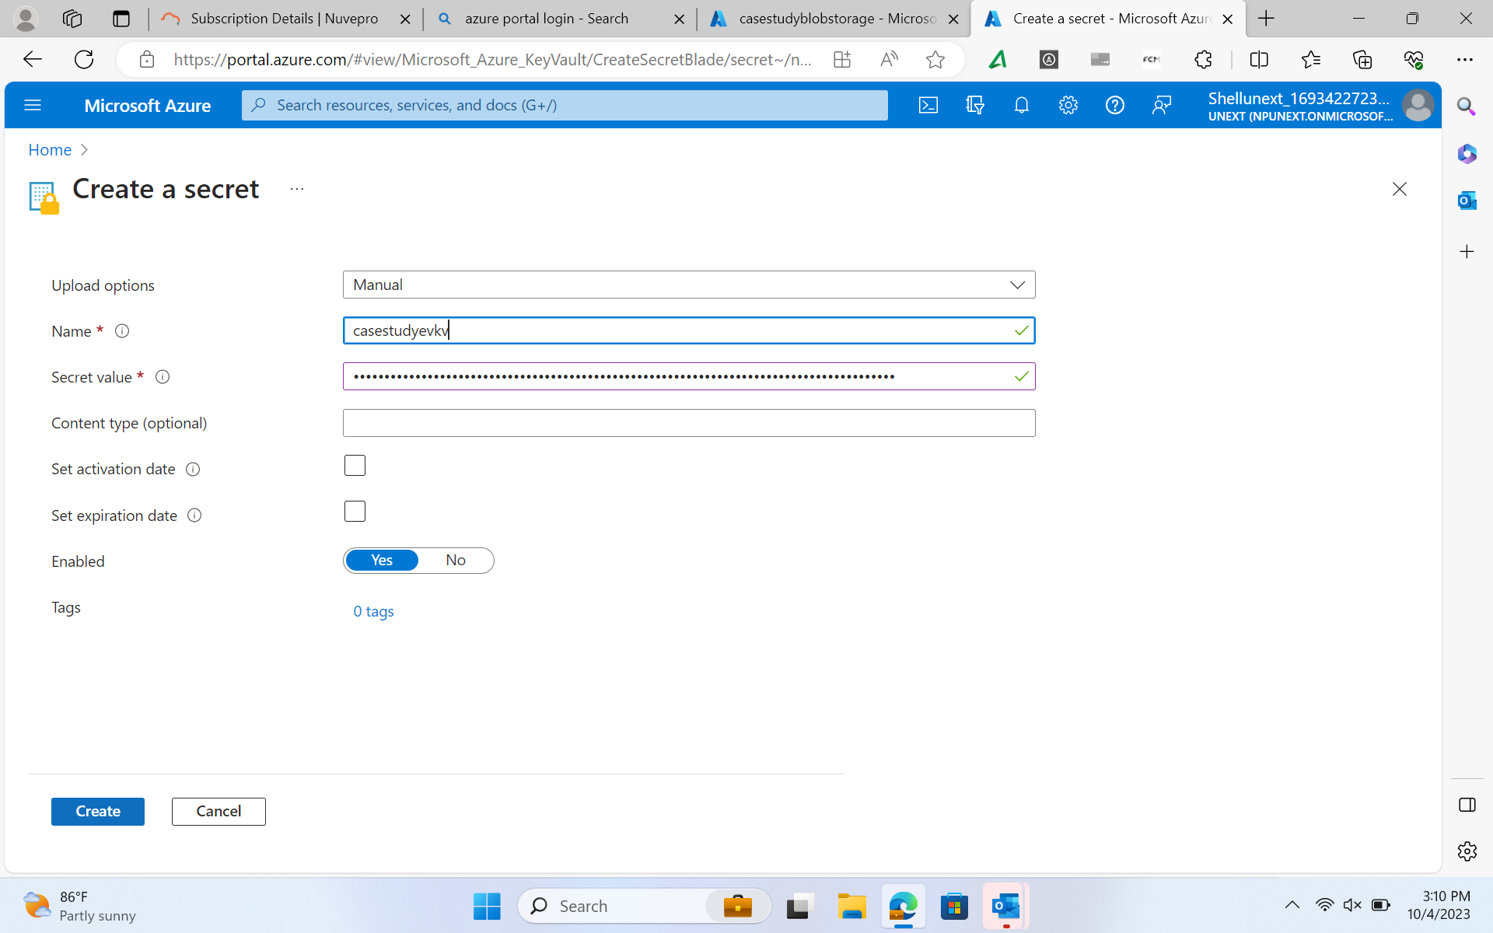
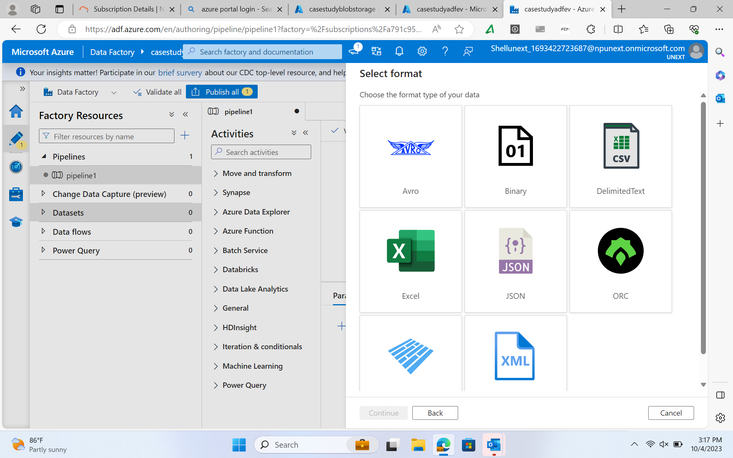

Slide 46
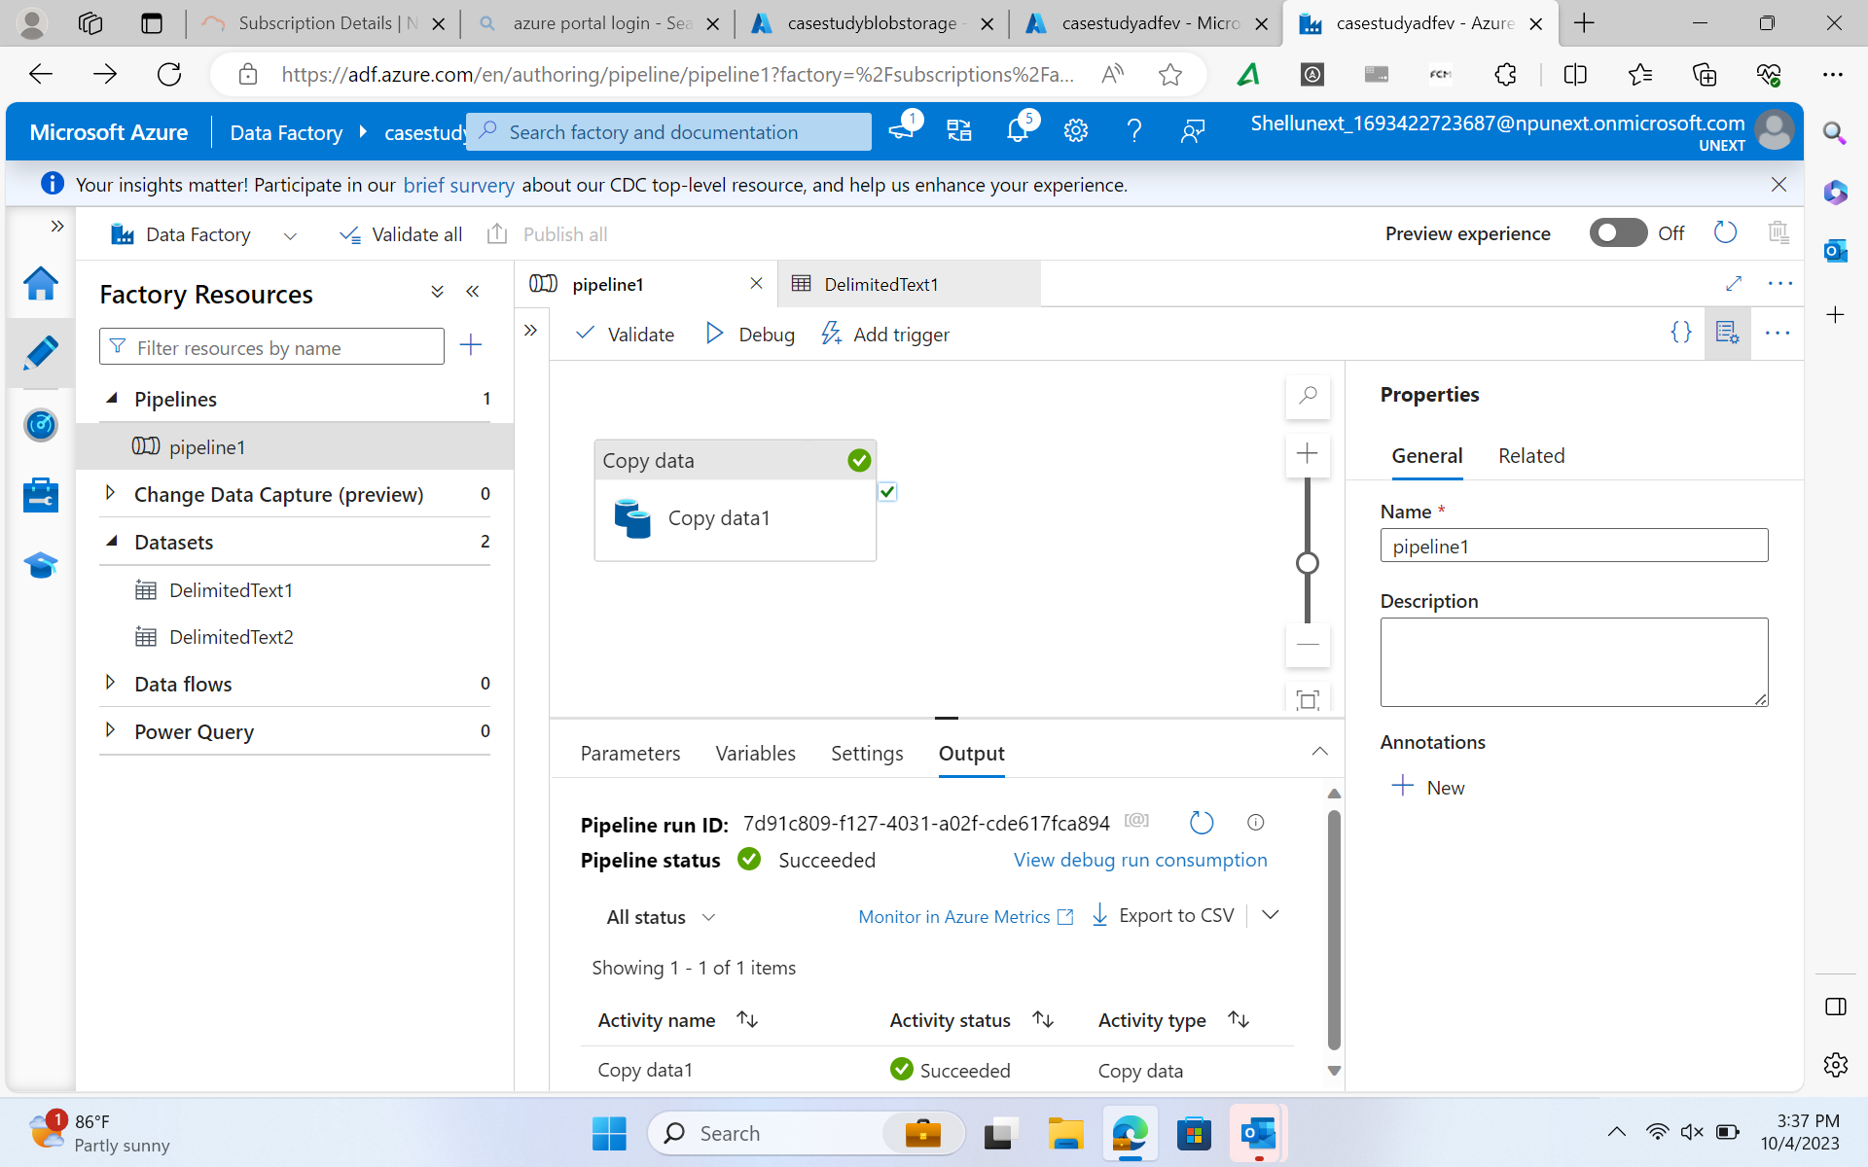
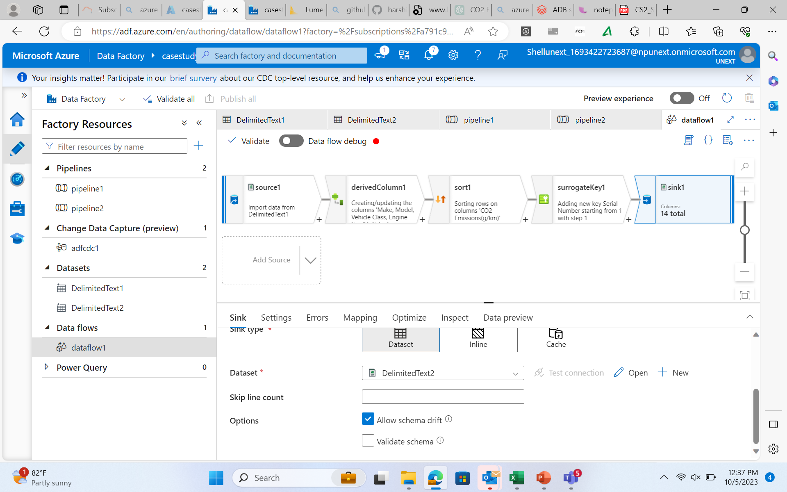

Slide 47
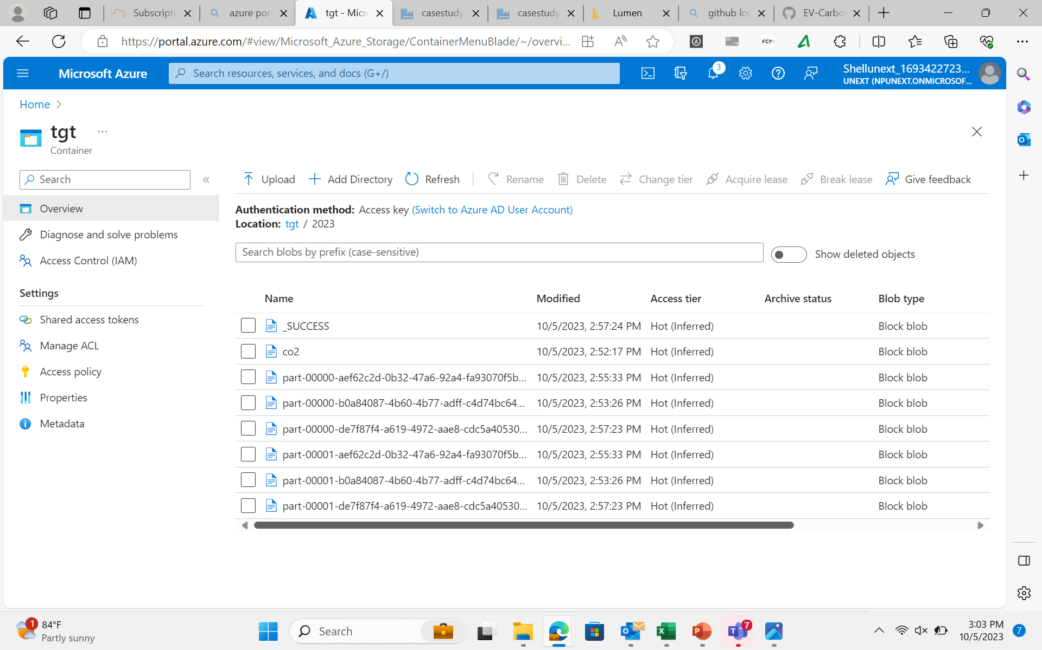
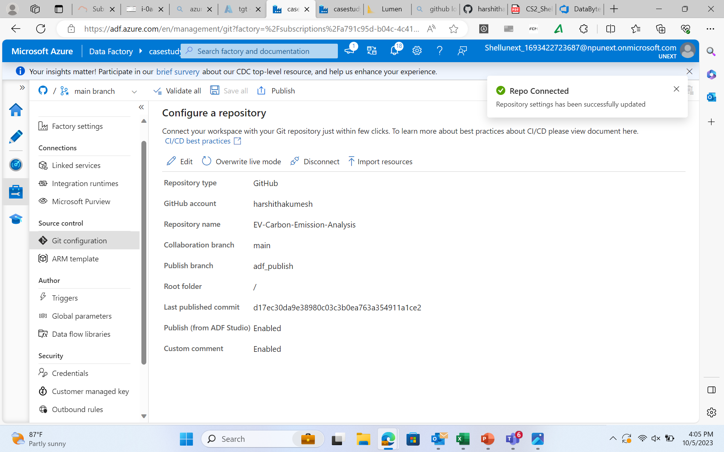

Slide 48
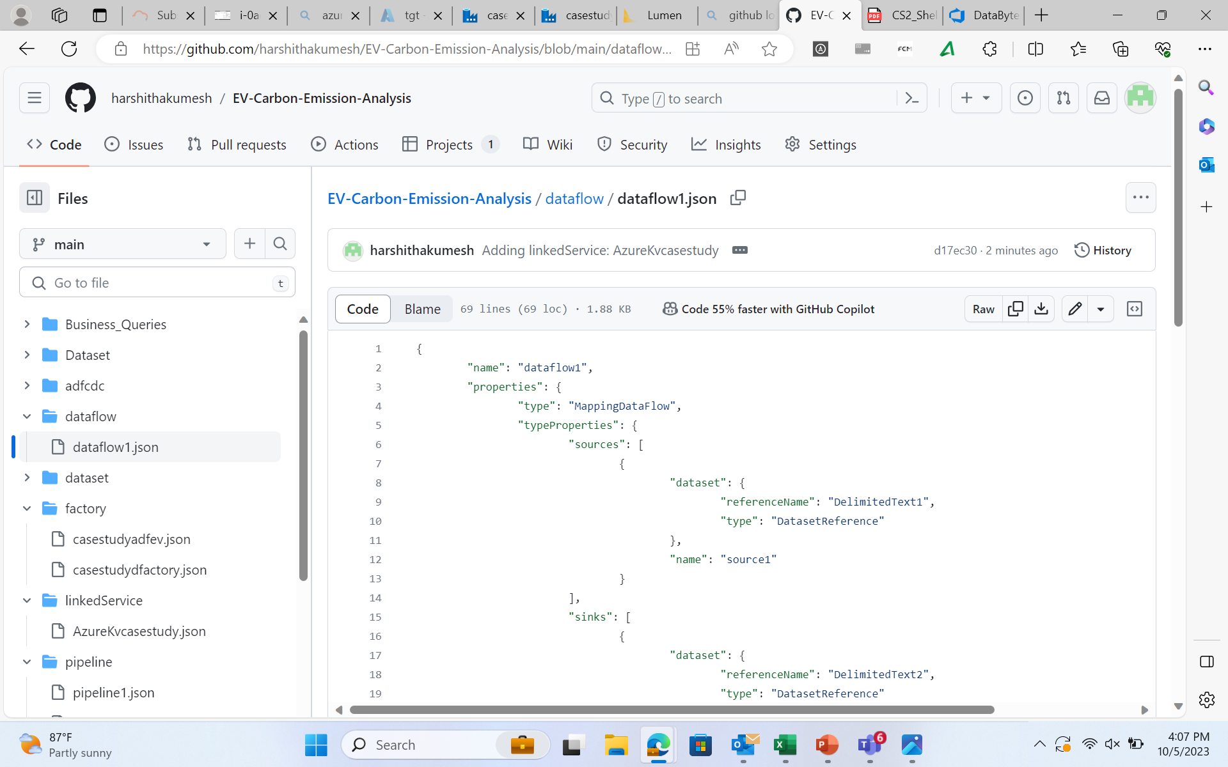
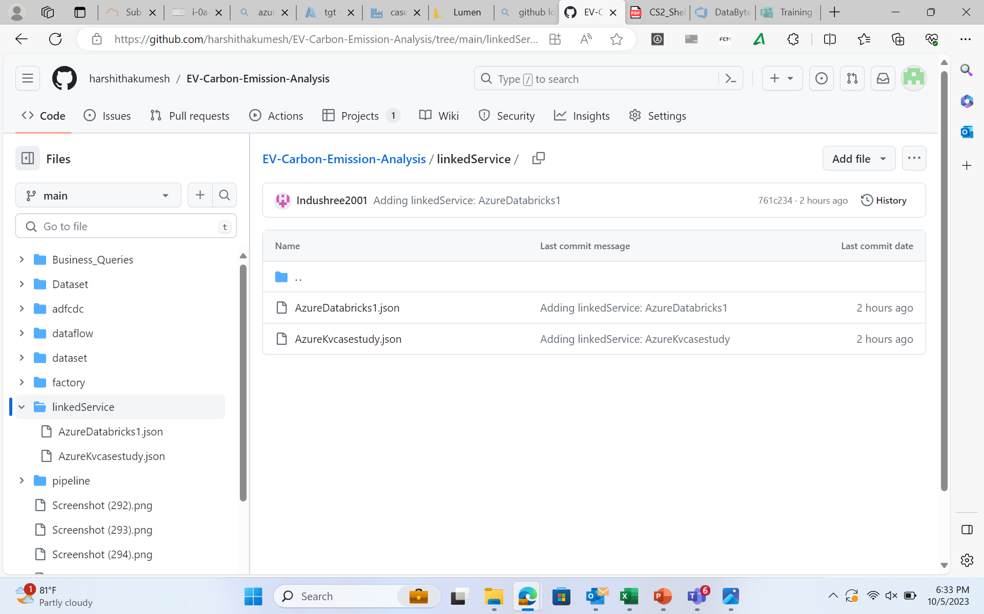

Slide 49
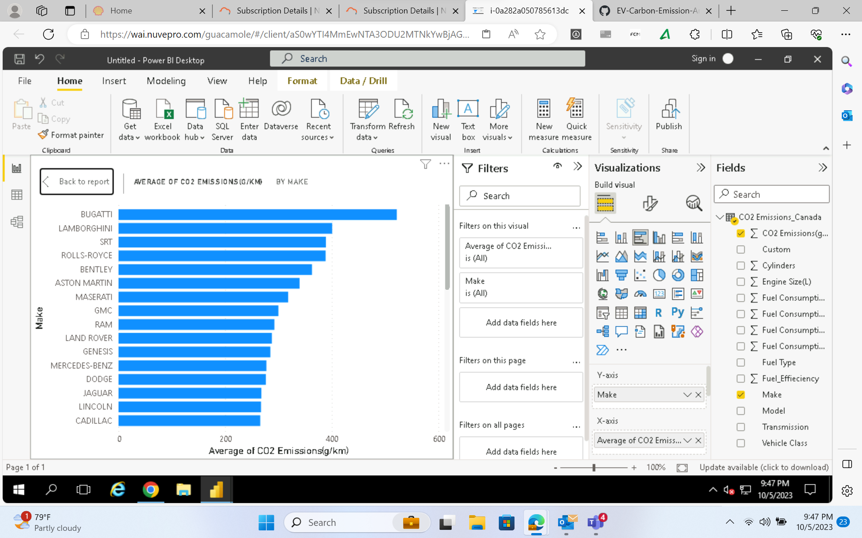
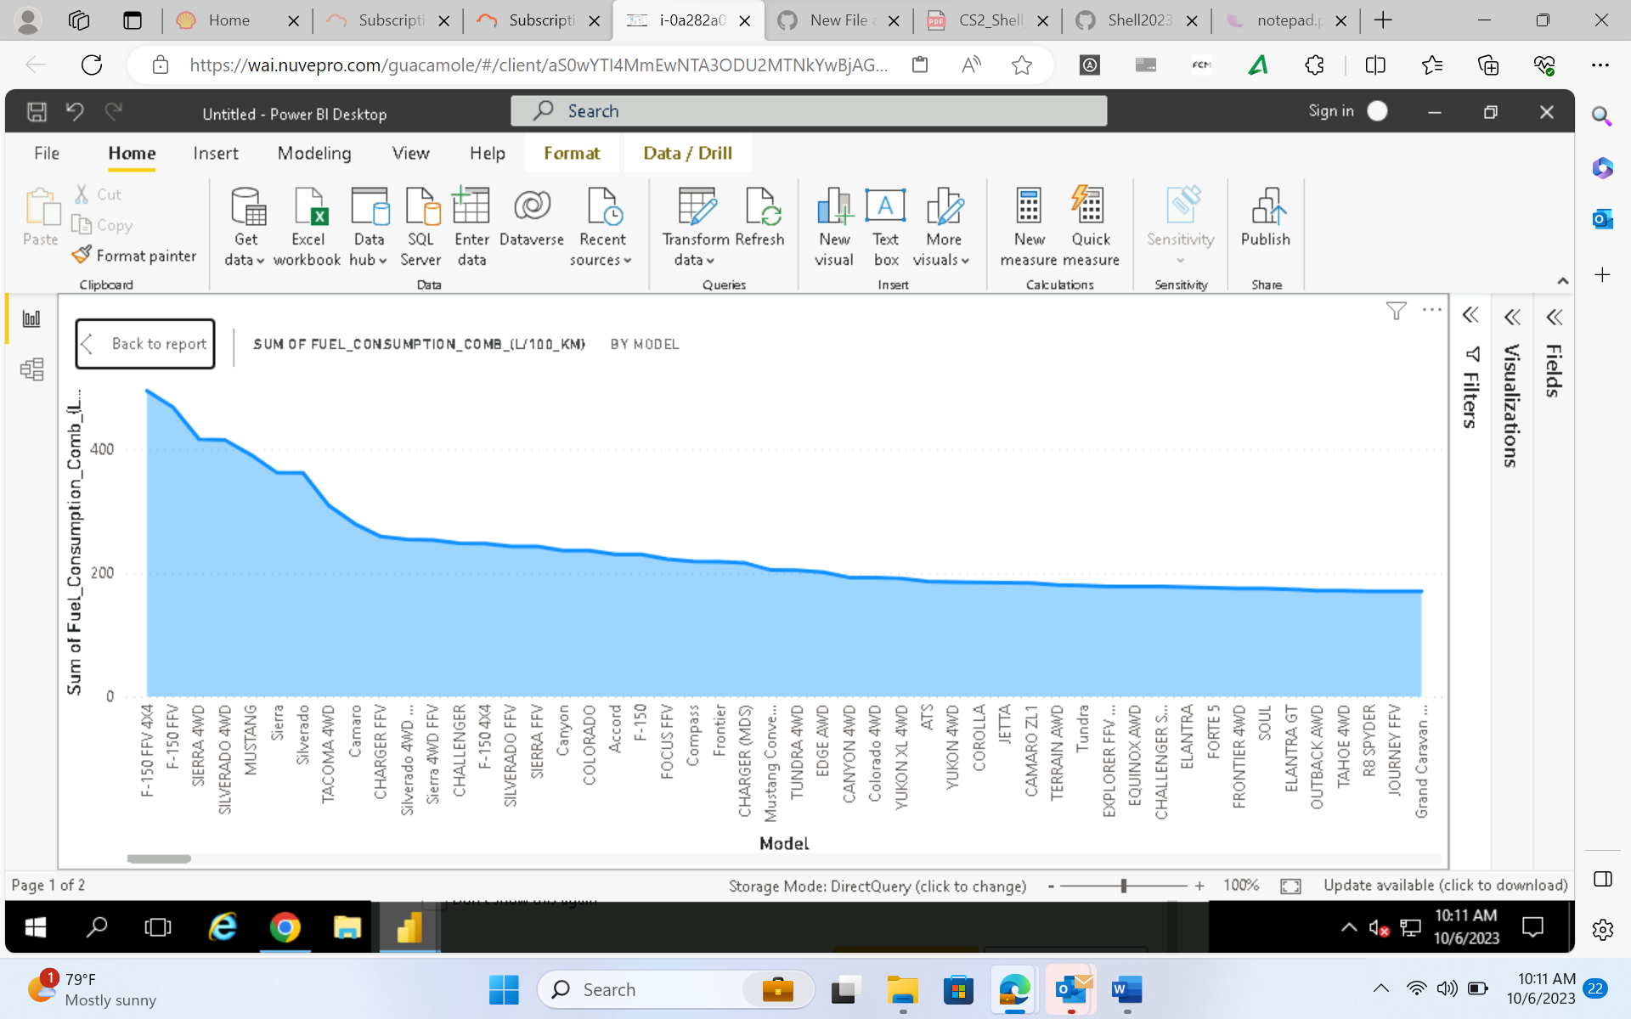

Slide 50
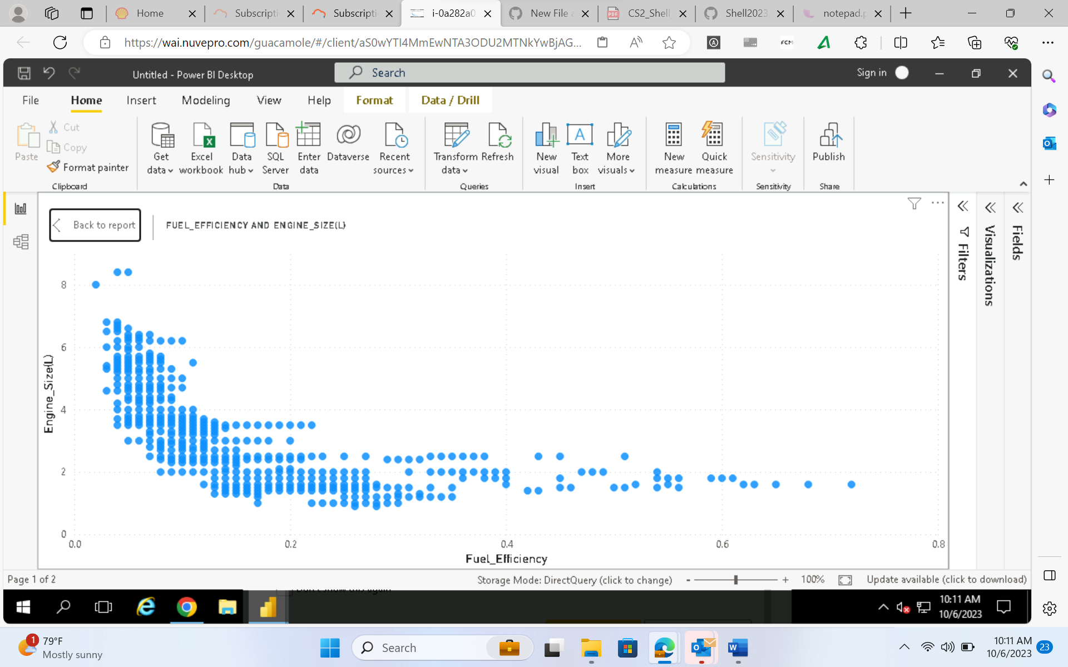
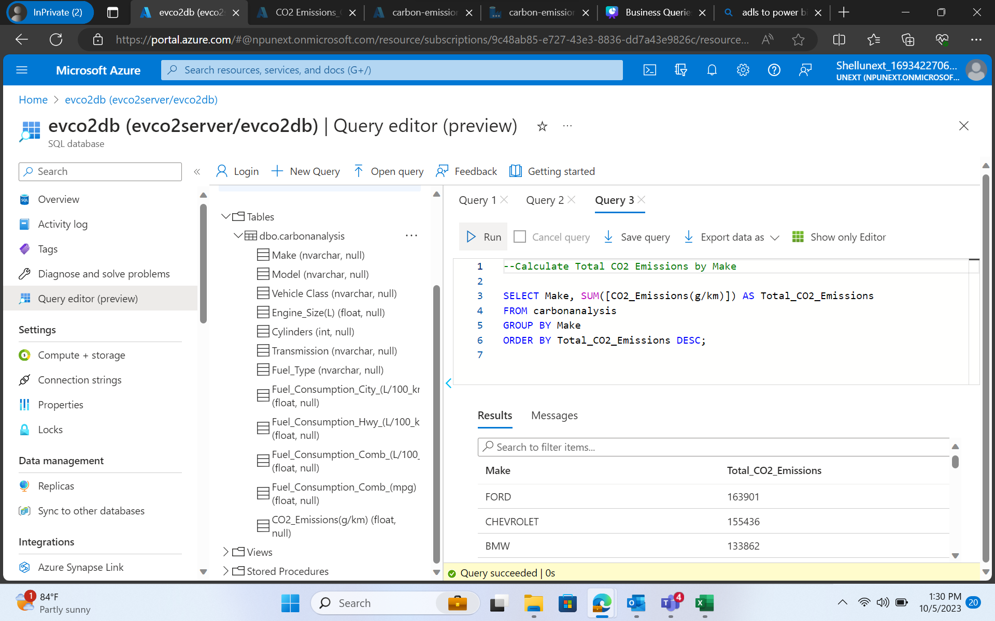

Slide 51
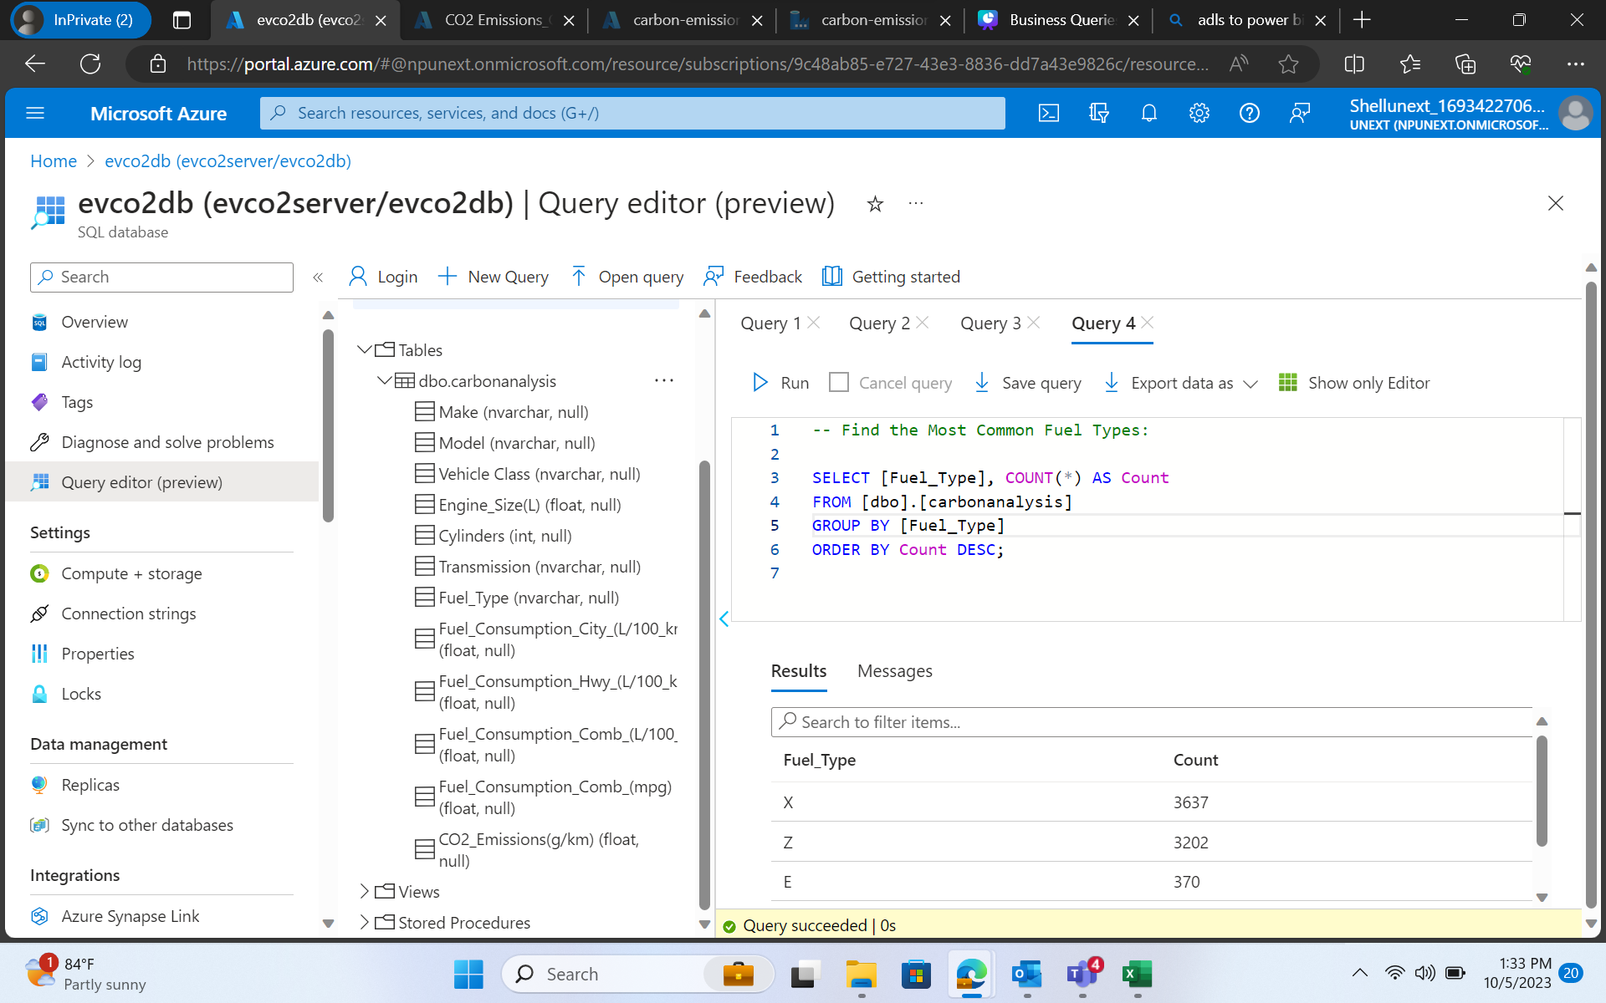
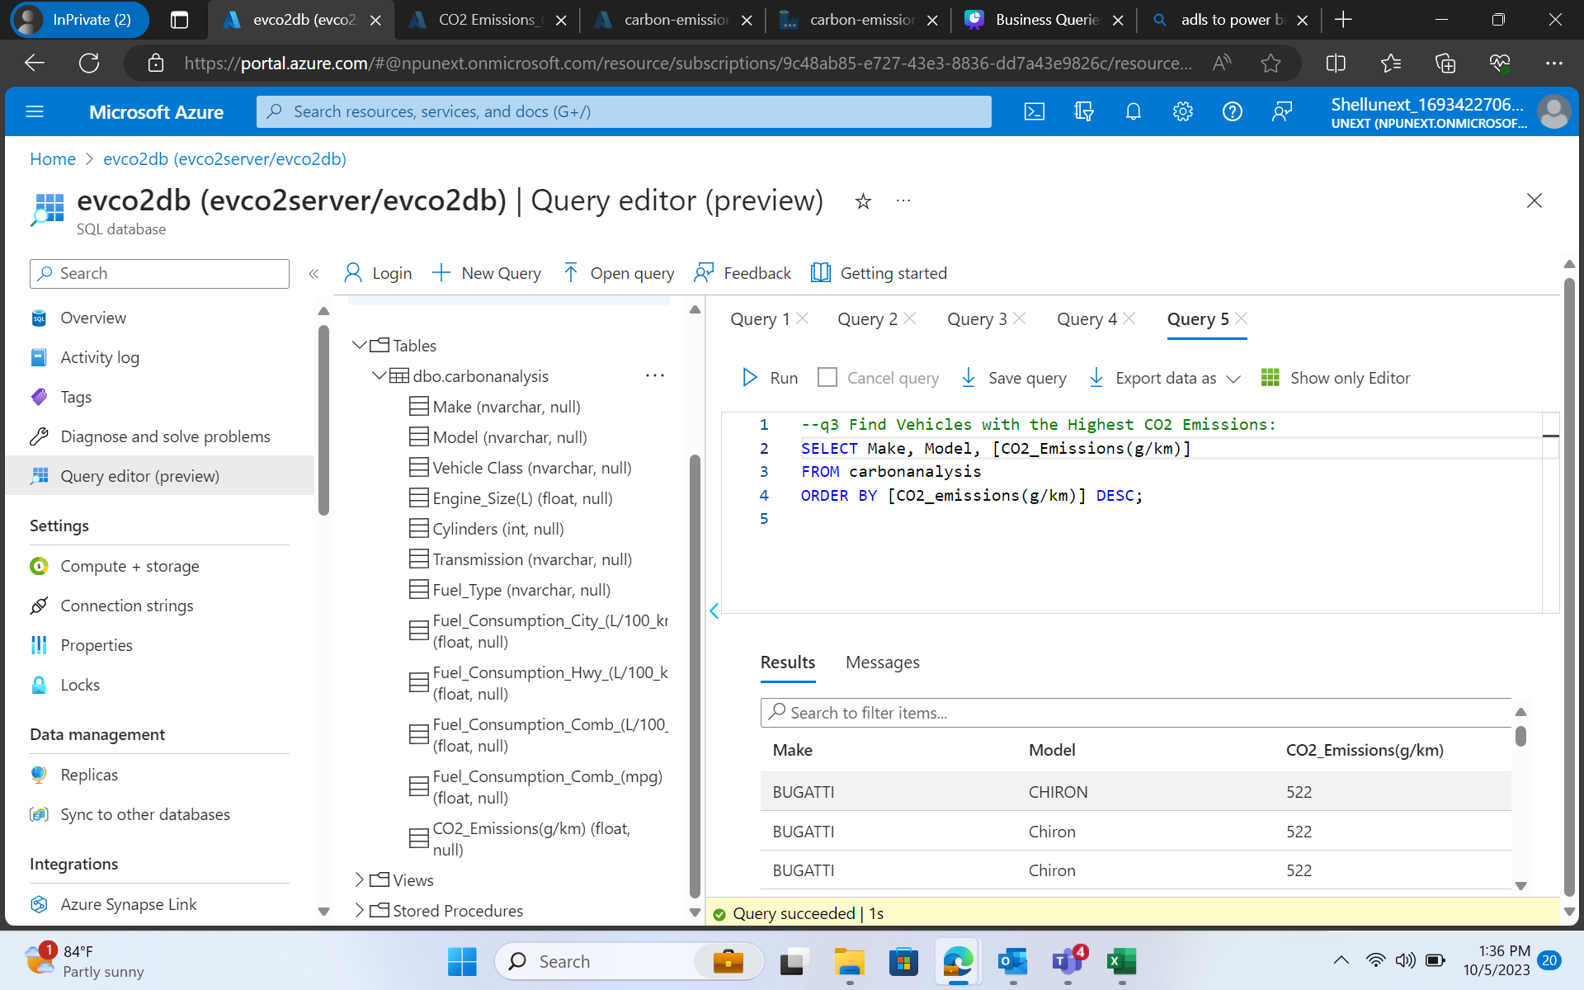

Slide 52
THANK YOU

